Slide 1

Mashrruca Barwaaqo: Baanka Adduunka – Dowladda Somaliland
Qorshaha Horumainta Bulshada 2024—2028
Tuulada Weraarta, Degmada Cadaadlay ee Gobalka Maroodijex
Nidaamka Biyaha: Dhisida Dhaam Biyood Cusub .
Barta Uu Kuyaalo: 70 km Waqooyi bari Hargaysa. GPS: N: 9.6982 E: 43.6728
Tirada Bulshada: 2,500 households oo degaan ah
Tuulooyinka Hoos Yimaada: 8.
Ilaha Dhaqaalaha Muhimka Ah: Xoolo Dhaqato Beeralay ( Geel, Lo,o, Adhi, dameero iyo dhaqashada shinida). Falashada beeraha roobka ku baxa iyo xaagsatotada
Leadership: Village Development Committee of 7 (7 men, 0 women), Elders committee.
Aragtida Bulshada
Bulshada Guud: In la helo bulsho isku tiirsan oo leh mustaqbal barwaaqo joogto ah leh, sidoo kale ay bulsgadu kawada qayb gasho, in la gaadho helitaanka biyo joogta ah sanadka oo dahan, jiritaanka adeegyo waxbarasho iyo caafimaad oo shaqaynaya, koruqaadista adeegyada waxsoosaarka beeraha, in la yareeyo carro guurka. In la arko dhoofinta khudaarta kala duwan oo kobcasa Haweenka : In ay arkaan degaanka oo helaya biyo joogta ah sanadkoo dhan, adeeg cafimaadka iyo waxbarashada oo ay si fudud ugadhi karaan. Sidoo kale in la xoojiyo awooda, xirfadaha iyo adkaysiga haweenka iyadoo la sinaayo taageerada lagama maarmaanka ah. Dhaliyarada Dumar ah: In kor looqaado helitaanka biyo joogta ah, waxbarasho heerkeedu sareeyo, adeeg caafimaad oo dhamaystiran, kaabayasha dhaqalaha bulshada oo carsi ah, iyo in kor loo qaado wacyigalinta tacadiyada la xidhiidha jinsiga iyo la abuuro adeeg ay wada gaadhi karaan ahweenku. Dhaliyarada Raga ah: In ay arkaan dhalinyarada tuulda oo la horumariyay iyadoo la siiyay tobaro xifadaha farsmada gacanata iyo tobabarada kaleba, in aanay dhicin biyo yaraan sanadka oo dhan iyo in dhalainyaradu si xor ah ugu ciyaaraan garoomo kubada cagta ah oo casriya. Dadka Qaba Baahiyaha Gaarka ah : In Arkaan degaanka weeraarta oo ah meel ay si firfircoon uga qayb qadan karaan dhamaan go,aamada bulshada, shirarka, anay gadhi karaan adeega caafimaad, adeega safarada iyo dhismayaasha kabayasha dhaqalaha laga dhigo kuwo ufudud isticmaalka dadka baahiya gaark ah qaba.
Arimaha Hortabinta U leh Bulshada
Maamulka Illaha Biyaha | Dhisida dhaam biyood cusub, taangiga kayd, nidaamka tamarta cadceeda, qasabada iyo dararka xoolaha, xaydaab siliga iyo qolka waardiyaha Nidaamka qasabadaha sooqadaya oo qaybinaaya biyaha Tobabarada gudiga maamulka biyaha
Xoolaha iyo Beeraha | Xoolaha Bixinta adeega caafimaadka xoolaha Koruqdista waxsoosaarka calafka xoolaha iyo farsamayntisa Nidaamka dib uxoolaynta qoyasaska Taagerada xaga suuqgaynta canaha ee dumarka caanaha ka shaqaysta Kor uqaadista dhaqashada shinida iyo digaaga Beeraha Helitaanka abuurka midhaha oo tayadisu aad u sarayso. Maraaynta cayayaanada iyo xanuunada beeraha In la siiyo tobabaro kor uqaadista waxsoosaarka beeraha Qaybinta qarbadada lagu kaydsao biyaha roob, laguna waraabiyo beeraha
Degaanka | Tobobarada laxidhiidha maamulka khayraadka dabiiciga ah Fulinta shaqooyin lagu ilaalinayo carrada iyo biyha Dhirayn degaanka In shaqo loo abuuro qoysaska ku tiirsan dhuxusha

Slide 2
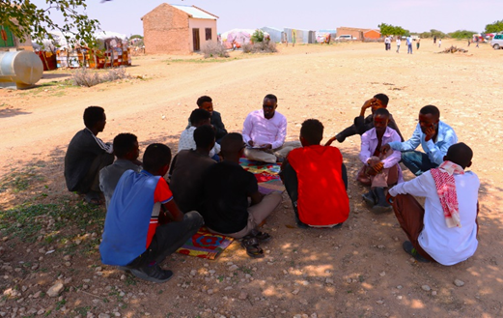
Taariikhda of CIP lafuliyay: 2-5 September 2024
Tirada Dadka Lala Tashaday
7 xubnood oo gudiga tuulada ah (7 raga, 0 dumara)
10 Haweena
16 Dhalinyara(12 ragga 4 dumara)
11 Beeralay (7 raga, 4 dumara)
12 Xoola dhaqato ah (7 raga 5 dumara)
4 gudiga biyaha ah (4 raga, 0 dumara)
115 bulshada guud ah (83 rag, 32 dumar)
Kooxda CIP Ka Fududaysay (10% ayaa dumar ah):
Qaybta hirgalinta Mashruca Barwaaqo : khabiirka badqabka bulshada, Khabiirka Xagudubyada Jinsiga , Khabirka xidhiidhinta mashruca , Lataliyaha Diyarinta qorshaha horumarinta bulshada iyo sargaalka qorshaha horumarinta bulshada
Khabiirada Ka Socda Wasarada Mashruuca Fuliya: Khabiirada xoolaha, beeraha, degaanka iyo biyaha.
Tuulada Garabis : Gudomiyaha, Gudiga horumarinta Tuulada , iyo Qaybaha kala duwan ee Bulshada ,
Jadwalka Xilli-Taariiikheedka
Goobta: Weraarta | Abr. | Maaj | Juun. | Luul. | Ogo. | Sebt. | Okt. | Nof. | Dis. | Jan. | Febr. | Maarj.
Sanadka Xiliyadiisa | Gu’ |  |  | Xagaa |  |  | Deyr |  |  | Jiilaal
Roobka | X | XX | X | XX |  |  | X X | X | X
Xilliga xooluhu Rimaan |  |  |  |  |  |  |  |  | X | X | X | X
Xilligu ay xooluhu dhalaan | X | XX
Wakhtiyada calafka La Heli Karo | XX | XX | X | X | X |  | XX | X | X | X
Wakhtiyada Canaha iyo Subaga la heli karo |  | XX | X |  |  | X | XX | XX
Xiliyada Ugu fican Iibka Xolaha | XX | XX | XX | X | X | X | X | X | X | X | X | X
Wakhtiyada xooluhu ka hayaaman degaanka |  |  |  |  |  |  | X |  |  |  |  | XX
Wakhtiyada Cudurada xoolaha badan yihiin |  |  |  | X | X |  |  |  |  | X | X | XX
Xilliyada Gaajada |  |  |  |  |  |  |  |  | X | X | X
Wakhtiyada Cudurada dadka ku dhaca ay badan yihiin |  |  | X | X |  |  |  |  |  | X | X | XX
Wakhtiyada la beero dalagyada daruuriga ah |  |  |  |  | XX |  |  |  |  |  |  | X
Xiliga goosashada beeraha |  | X |  |  |  |  |  |  | X
Xilliyada guurka Badan yahay | X | XX |  |  |  | X | XX | X |  |  |  | X
Xilyada Wax aad Loo Amaahdo |  |  |  |  |  |  |  |  |  | X | X | X
Wakhtiyada Iskoolka La dhigto | X | X | X |  |  | X | X | X | x |  | X | X

Slide 3
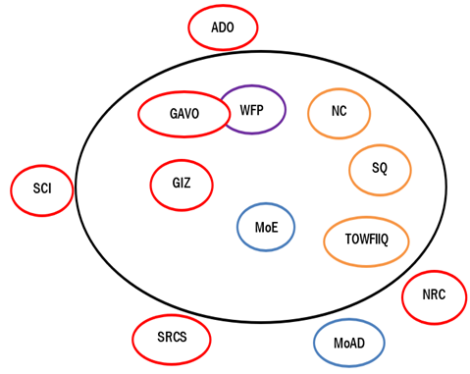
Hayadaha/Ururada Tuulada Ka Shaqeeya
Ururka amma Hayada lad | Shaqooyinka Muhimka ah
Hayada Cuntada Aduunka /GAVO | Taagero cunto, quudinta ardayda, tageero lacageed, iyo dhismaha dahaam biyood
GIZ | Dib uhabayn berkad iyo tageerada dhanka beeraha ah
Hayada, bisha cas | Agabka fayadhowrka, wacyigalin caafimaad iyo taagero lacageed
NRC | Dhismaha dugsi iyo tobabarka macalimiinta
Wasaarada Waxbarashada | Dhismaha dugsiga, mushaharka macalimiinta iyo qalabaynta dugsiga
Hayada Badbadada Caruurta | Dib udhiska dugsiga, dirayska ardayda, iyo agabka ka hotaga xanuunka COVID ka
Hayada Horumarinta Beeraha (ADO) | Moosas carro guurka ka hortaga, iyo dhismaha suuliyaal
Wasaarada horumarinta beeraha | 200 sacdood o qodaal ah
TAWFIQ | Ka shaqynta iibka caanaha iyo iskashatooyink dumarak
Nabad iyo Caano | Ka ganacsiga xoolaha
Soo qaado | Ururinta iyo iibinta caanaha

Slide 4
Howlaha Waxqabad ee Laga Maalgalinayo Mashruuca Barwaaqo
Howlaha waxqabad | Faahfahinta Waxqabadyada (quantities, hectares…)
Dhismaha Dhaam Biyood Cusub | Dhismaha Dhaam biyood cusub oo leh cabirka 40m balaca, 40m dhererka iyo 3.16 m oo joog ah, kasoo la dhigayo qarbidka biyaha haya. Samaynta kayd kor loodhisay, qasabadaha biyaha laga cabo, 1 dararka xoolaha, qolalka waardiyaha iyo ka alaabta lagu kaydiyo iyada biyaha looga soo saarayo nidaamka tamarta cadceeda Tobabarka gudiga maamulka biyaha
Dhismaha Xarun Caafimaad | Dhismaha Xarunta Caafimadka xoolaha
Toabarida iyo agab siinta daryelayasha caafimaadka xoolaha | Taagero tobabaro, dawooyinka iyo agabka xooloaha lasiiyo daryeelayaasha caafimadka xoolaha
Kor uqaadista soosaarista calafka xoolaha | In la dhiso lana tobabaro 8 iskaashatada soo saarista calafka xoolaha lagana taagero tobabaro la xidhiidha kor uqaadista waxsoosaarka xoolaha iyo farsamayntisa
Dib u xoolaynta qoysaska nugul | In loo qaybiyo 450 adhi ah iyo 30 damerood 30 qoys, oo ah qoysaska nugul ee bulshada
Kor uqaadista xirfadaha dahqashada shinida iyo khayradleda | In lasiiyo sanaduuqda shinida, dirays, galoofisyada iyo qiijiyyaasha 15 qoys oo danyara, oo ay ku jiraan 8 qoysk oo dumar hogaminayaan Tobabarka dhaqashada shinida, maraaynta gurashada malabka, iyo maraaynta/dibuhagaajinta sanduuqayda shinida Ka warhaynta suuq gaynta waxsoosaarka shinida
Hababka Ilaalinta Caradda iyo Biyaha | In la dhiso Moosaska ilaaliya carrada iyo biyaha oo dhararkodu yahay 14,800 (udhiganta 75 hiktar),) iyo 80 m3 oo moosaska dhagaxa ah (u dhiganta 5 hiktar)
Dhisida iskaashato beeralay | Dhisida iyo toabarida iskaashato beeralay iyo inloo samaeeyo hagaha iyo xeerhoosaadka iskaashatada
Dhisida xarun lagu isugu keeno caanaha | In ladhiso1 xarun oo la isugu keeno caanaha oo leh qaboojiye ku shaqaynyna nidaamka tamarta cadceeda. In la isu dubarido oo laga dhigo iskaashato dumarka ka sahqeeysta suuqgaynta caanaha , sidoo kalana loo qaybiyo agabka nadaafada caanaha loo isticmaalo
Kor uqaadista dhaqashada digaaga | Soo ibinta iyo qaybint 100 nooca digaaga adkaysiga u leh cimilada adag, oo loo qaybiyo 20 qoys( 5 xabo qoyskiba). In loo dhiso guryaha digaaga oo casri ah, meelaha ay ku xerodaan, quudiyayaal, iyo melaha ay biyaha ka cabayaan In lasiiyo tobabaro itusoo u=itaabsi ah oo ku saabsan dhaqashada digaaga
Taagerada Agabka Beeraha | Taageerada abuur tayadisu sarayso, agabka gacanta iyo maishinada beeraha oo alsiiyo 50 beeralay Toabaro la xidhiidha nidaamka fiican ee waxberashada; sida maaraynta xanuunada iyo cayayaanada beeraha Qaybinta qarbadada biyaha roobka lagu kaydsado oo lasiiyo 10 beeralay
Taageerada girgirayaasha tamarta madhxiya | In loo qaybiyo 150 qoys girgiyaasha tamarta madhxiya
Tobabar Maaraynta khayraadka dabiiciga ah | Diyaarinta hagaha tobabarka, doorashada ka qayb galayaasha iyo bixinta tobabarka lagu bixinata xarunta bandhiga
Dib-usoo celinta dhul daaqsimeedka | Dib-usiidhinta dhuldaaqsimeedka( 1000kg oo lagu siidhiyo 83 hiktar)
Dhisida Guddi Maamusha Dhul daaqsimeedka | Dhisida iyo tobabarida gudi maamulka dhul daasmieedka

Slide 5
Howlaha kale ee hortabinta u leh tuulada: maalgelinta looga raadinaayo mashruucada kale
Caqabadaha Gaarka Ah | Waxa Loo Bahanyahay in Laga Qabto
Helitaanka Adeeg waxbarasho | In la dhiso, lagana sahqaysiyo dugsi sare
Tayo xumo adeega waxbarashada | Dhismaha dayrka dugsiga iyo cagaarinta garoonka kubada cagta
Jiritaan la, aanta fursadaha tobabarada xirfadaha | Qabuurista fursado tobabaro farsmooyinka gacanta iyo abuurista xarumo farsamo gacmeed
Jiritaan la,aanta adeegyadda caafimadka | Qalabaynta adeega caafimaadka, dawooyinka, iyo mushaharaadka shaqalaha
Dabargoynta iyo maaraynta dhirta degaanka ku faafa | Kaqayb qaadashada iyo abaabulka bulshada ee dabargoynta dhirta kufaafta degaanka iyo la helo hab loo isticmaalo dhirtaa si loo xakameeyo

Slide 6
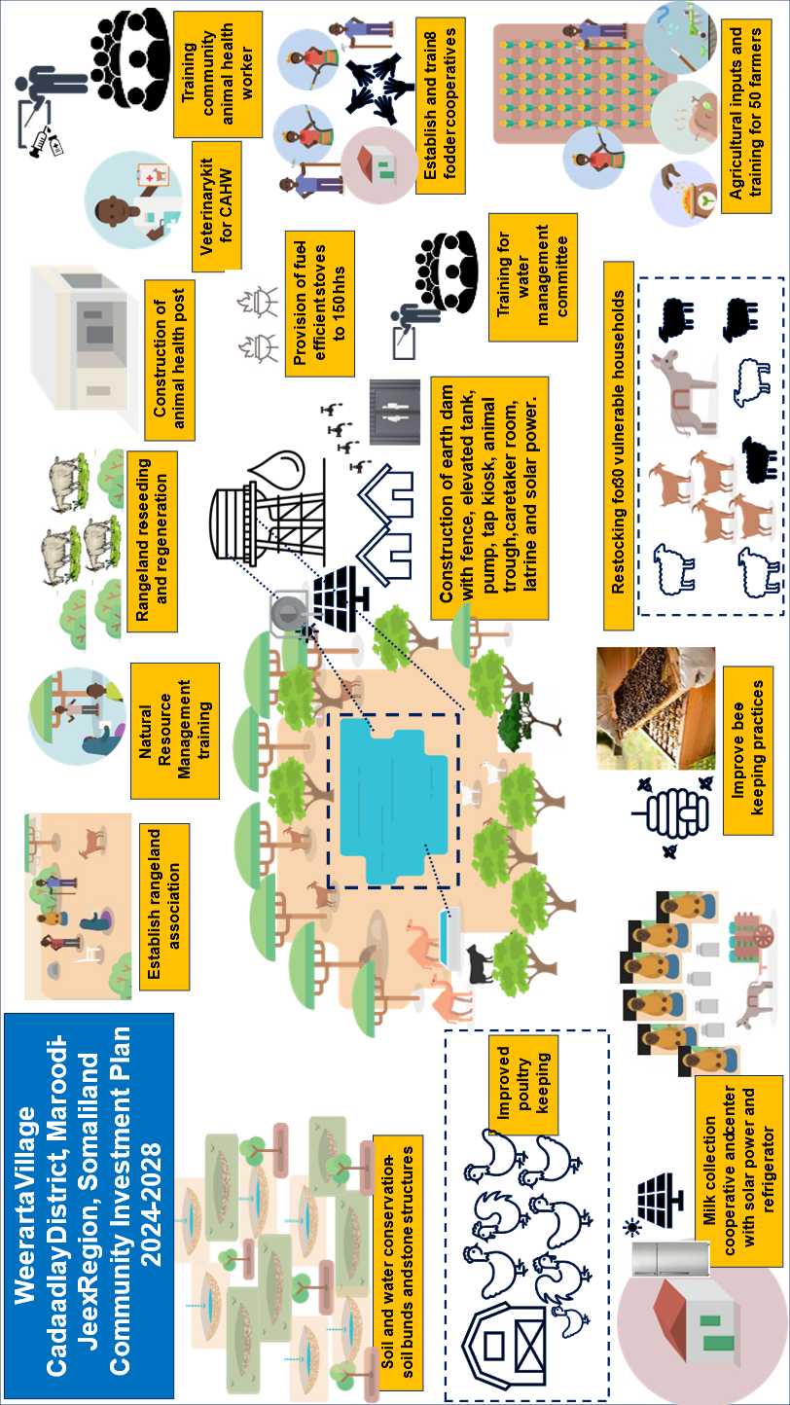
Jaantuska Qorshaha Maalgelinta Tuulada oo Kooban

