Slide 1

Mashrruca Barwaaqo: Baanka Adduunka – Dowladda Somaliland
Qorshaha Horumainta Bulshada 2024—2028
Tuulada Qoton dabo, Degmada Hargiesa ee Gobalka Maroodijex
Nidaamka Biyaha: Dhisida Dhaam Biyood Cusub .
Barta Uu Kuyaalo: 75 km Koonfur galbeed Hargaysa. GPS: N: 9.18330 E: 43.9557
Tirada Bulshada: 3,000 households oo degan ah iyo in ka badan 200 oo reeguraa biyaha soo doonta xiliyada abaarta.
Tuulooyinka Hoos Yimaada: 3.
Ilaha Dhaqaalaha Muhimka Ah: Xoolo Dhaqato ( Geel, Lo,o, Adhi, dameero iyo dhaqashada shinida). Falashada beeraha waa ku cusub tahay degaanka ilaa 25 qoys ayaa bilaabay falashada beeraha waxany beertaan midhaha sida; garow, digirta, tomato iyo xabxab.
Leadership: Village Development Committee of 7 (7 men, 0 women), Elders committee.
Aragtida Bulshada
Bulshada Guud: In la gaadho helitaanka biyo joogta ah sanadka oo dahan, Sidoo kale helitaanka adeegyada cafimaad xoolaha iyo dadka oo kor looqaday, agabka waxsoosaarka beeraha iyo inay loo badalo dhul daaqsimeedka goobo suurtagal ah oo wax-soo-saar caws iyo daaq ah Haweenka : In ay sanadkoo dhan helaan biyo joogto, daryeelka cafimaadka iyo waxbarashada oo kor loo qaaday. Sidoo kale in la xoojiyo waxsoosaarka xoolaha si ay adkaysi ugu yeshaan abaaraha, sidoo kalana ay haweenku helaan taageerada ay ubahan yihiin. Dhaliyarada Dumar ah: In ay arkaan tuulada oo haysta biyo nadifa, waxbarasho tayadeedu sarayso, adeeg caafimaad oo dhamaystiran, kaabayasha nolosaha oo casriyaysan iyo wacyigalinta tacadiyada la xidhiidha jinsiga oo marwalba la ahelaayo. Dhaliyarada Raga ah: In ay arkaan dhalinyarada tuulda oo la horumariyay iyadoo la siiyay tobaro xifadaha farsmada gacanata iyo tobabarada kaleba, in aanay dhicin biyo yaraan sanadka oo dhan iyo in dhalainyaradu si xor ah ugu ciyaaraan garoomo kubada cagta ah oo casriya.
Arimaha Hortabinta U leh Bulshada
Maamulka Illaha Biyaha | Dhisida dhaam biyood cusub, taangiga kayd, nidaamka tamarta cadceeda, qasabada iyo dararka xoolaha, xaydaab siliga iyo qolka waardiyaha Tobabarada gudiga maamulka biyaha
Xoolaha iyo Beeraha | Xoolaha Dhisida xarunta adeega caafimaadka xoolaha Koruqdista waxsoosaarka calafka xoolaha iyo farsamayntisa Kor uqaadista iyo dhisida awooda iyo xirfada daryeelayaasha caafiaamdka xoolaha Kor uqaadista dhaqashada shinida Beeraha Helitaanka mishiinada iyo qalab gacmeedyada beeraha Tobabaro la xidhiidha nidaamyada iyo xirfadaha waxberasho Helitaanka abuurka midhaha oo tayadisu aad u sarayso. Helitaanka qarbadada biyo lagu kaydsado si beeraha loogu waraabsado
Degaanka | Dhisida Moosaska carada iyo dhagaxa ee ka horatago caroguurka/nabaad guur Xakamaynta iyo maamulka geedaha garanwagaa iyo hiliglaha Dhirayn degaanka In shaqo loo abuuro qoysaska ku tiirsan dhuxusha

Slide 2
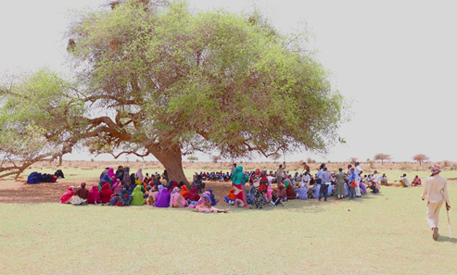
Taariikhda of CIP lafuliyay: 4-7 May 2024
Tirada Dadka Lala Tashaday
7 xubnood oo gudiga tuulada ah (7 raga, 0 dumara)
42 Haweena oo dhalinyarada haweenkuna
9 Dhalinyara raga
5 Beeralay (5 raga, 0 dumara)
10 Xoola dhaqato ah (10 raga 0 dumara)
7 gudiga biyaha ah (6 raga, 1 dumara)
130 bulshada guud ah (83 rag, 47 dumar)
Kooxda CIP Ka Fududaysay (20 % ayaa dumar ah):
Qaybta hirgalinta Mashruca Barwaaqo : khabiirka badqabka bulshada, Khabiirka Xagudubyada Jinsiga , Khabirka xidhiidhinta mashruca , Lataliyaha Diyarinta qorshaha horumarinta bulshada iyo sargaalka qorshaha horumarinta bulshada
Khabiirada Ka Socda Wasarada Mashruuca Fuliya: Khabiirada xoolaha, beeraha, degaanka iyo biyaha.
Tuulada Garabis : Gudomiyaha, Gudiga horumarinta Tuulada , iyo Qaybaha kala duwan ee Bulshada ,
Jadwalka Xilli-Taariiikheedka
Goobta: Qoton Dabo | Abr. | Maaj | Juun. | Luul. | Ogo. | Sebt. | Okt. | Nof. | Dis. | Jan. | Febr. | Maarj.
Sanadka Xiliyadiisa | Gu’ |  |  | Xagaa |  |  | Deyr |  |  | Jiilaal
Roobka | X | XX | X | XX |  |  | X X | X | X
Xilliga xooluhu Rimaan |  |  |  |  |  |  |  |  | X | X | X | X
Xilligu ay xooluhu dhalaan | X | XX
Wakhtiyada calafka La Heli Karo | XX | XX | X | X | X |  | XX | X | X | X
Wakhtiyada Canaha iyo Subaga la heli karo |  | XX | X |  |  | X | XX | XX
Xiliyada Ugu fican Iibka Xolaha | XX | XX | XX | X | X | X | X | X | X | X | X | X
Wakhtiyada xooluhu ka hayaaman degaanka |  |  |  |  |  |  | X |  |  |  |  | XX
Wakhtiyada Cudurada xoolaha badan yihiin |  |  |  | X | X |  |  |  |  | X | X | XX
Xilliyada Gaajada |  |  |  |  |  |  |  |  | X | X | X
Wakhtiyada Cudurada dadka ku dhaca ay badan yihiin |  |  | X | X |  |  |  |  |  | X | X | XX
Wakhtiyada la beero dalagyada daruuriga ah |  |  |  |  | XX |  |  |  |  |  |  | X
Xiliga goosashada beeraha |  | X |  |  |  |  |  |  | X
Xilliyada guurka Badan yahay | X | XX |  |  |  | X | XX | X |  |  |  | X
Xilyada Wax aad Loo Amaahdo |  |  |  |  |  |  |  |  |  | X | X | X
Wakhtiyada Iskoolka La dhigto | X | X | X |  |  | X | X | X | x |  | X | X

Slide 3
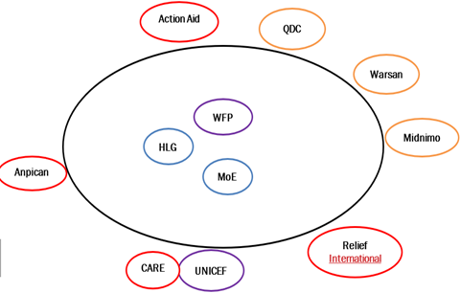
Hayadaha/Ururada Tuulada Ka Shaqeeya
Ururka amma Hayada lad | Shaqooyinka Muhimka ah
Hayada Cuntada Aduunka | Taageero maaliyadeed, cunto iyo nafaqada caruurta
ActionAid | Dhisme Balay biyood
Guddiga horumarint Tuulada Qotonka | Dhismaha xaumaha caafimaadka iyo booliska
ANNPCAN | Tageerada cafimaad, bixint 8 shaqaale mushaharkoda iyo nafaqada caruurta
CARE/UNICEF | Dhismaha dugsiga, quudinta ardayda iyo tageerada agabka waxbarashada
Relief Interbational | Tobabaro iyo tageero laxidhiihda xanuunada xoolaha
WARSAN | Talaalka xoolaha
Wasaarada waxbarashada | Mushaharaadka macalimiinta iyo agabka waxabarashada
Dowlada Hoose ee Hargaysa | 2 kamida shaqaalaha caafimaadka mushaharkooda
Midnimo | Dhismaha madarasada quraanka
Wasaarada xananada xoolaha | Talaalka Xoolaha

Slide 4
Howlaha Waxqabad ee Laga Maalgalinayo Mashruuca Barwaaqo
Howlaha waxqabad | Faahfahinta Waxqabadyada (quantities, hectares…)
Dhismaha Dhaam Biyood Cusub | Dhismaha Dhaam biyood cusub oo leh cabirka 40m balaca, 60m dhererka iyo 2.4 m oo joog ah, kasoo la dhigayo qarbidka biyaha haya. Samaynta kayd kor loodhisay, qasabadaha biyaha laga cabo, 2 dararka xoolaha, qolalka waardiyaha iyo ka alaabta lagu kaydiyo iyada biyaha looga soo saarayo nidaamka tamarta cadceeda
Dhismaha Xarunta caafimaadka | Dhismaha rugta caafimaka xoolaha
Tobabar iyo qalabaynta daryelayaasha caafimadka xoolaha | Taageero dawo iyo agabka lagu daweeyo xoolaha Tobabar kor uqaadis ah oo la siiyo 2da daryeele caafimaadka xoolaha ee jira
Kor uqaadista soosaarista calafka xoolaha | In la doorto lana diyaariyo 5 ha oo dhul daaqsimeed ku dhow dhaamka biyaha In lasoo iibiyo 200kg oo calafka xoolaha ee wanagsan In la dhiso lana tobabaro iskaashatada soo saarista calafka xoolaha Taageero 22.5 sacadoo oo qodaal calafa
Kor uqaadista xirfadaha dhaqashada shinida iyo khayraadka | Soo iibinta iyo qaybinta sanaaduuqda shinida, galoofisyada,qiijiyaha iyo dhamaan agabyada kale ee loo isticmaalo shini dhaqashada. Qalbkaa oo loo qaybiyo 30 qoys oo ah qoysaska nugul; kuwaas 10 kamida ay hogaminayaan dumar. In la siiyo tobabaro la xidhiidha dhaqashada shinida, goosashada malabaka iyo dayactirka sanduuqyada shinida
Tageerada agabka waxberashada | Abuurka beeraha iyo qalb gacmeedyada
Hababka Ilaalinta Caradda iyo Biyaha | In la dhiso Moosaska ilaaliya carrada iyo biyaha oo dhararkodu yahay 18,800 (udhiganta 80 hiktar), 100 m3 oo biyo-xidhenada dhagaxa ah( udhiganta 50 hiktar) iyo 80 m3 oo moosaska dhagaxa ah (u dhiganta 70hiktar) Tobab la xidhiidha qaabka samaytana moosaskan
Maaraynta Garanwaaga | Tobabaro ku saabsan maaraynta geedka garanwaaga iyo taagero qalabka loo isticmaalayo maaraynta garanwaaga
Dhisida dugsi beereedyo | In la dhiso 1 dugsi beereed lana siiyo tobabaro ku saab habka wanaagsan ee waxbershada oo ay ku jiraan nidaamka dhamaytiran ee maaraynta xanuunada iyo cayayaanada
Dib u dhiraynta degaanka | In la beero 2,000 oo geedaha asalka u ah degaanka
Dhisida Urur maamula dhul daaqsimeedka | In la dhiso lana tobabaro urur ilaaliya dhirta iyo dhul daaqsimeedyada
Taageerada girgirayaasha tamarta madhxiya | In loo qaybiyo 115 qoys girgiyaasha tamarta madhxiya

Slide 5
Howlaha kale ee hortabinta u leh tuulada: maalgelinta looga raadinaayo mashruucada kale
Caqabadaha Gaarka Ah | Waxa Loo Bahanyahay in Laga Qabto
Jiritaan la,aanta dugsi sare | In la dhiso, lagana sahqaysiyo dugsi sare
Jiritaan la,aanta xirfadaha iyo fursadaha tobabarada | In dhalinyarta loo abuuro fursado ay uga qayb gali karaan tobabarada casharada xirfadaha farsmada gacanta
Jiritaan la,aanta adeeg caafimaad oo udhow | Qalabaynta xarunta dhalaanka iyo hooyada, tageerada dawwoynka iyo shaqaalaha xarunta
Nadaafad darrada degaanka | Dhismayaal suuliyaal iyo meelo xidhan oo qashinka la iskaga ururiyo
Dhibaatooyinka geedaha garanwagaa iyo hilig oo aad ugu faafay degaanka | In la siiyo tobabaro ku saabsan qaababka loo xakamayn karo geedka garanwaaga iyo taageero qalab gacmeed iyo mashiino lagu xakameeyo geedka garanwaga

Slide 6
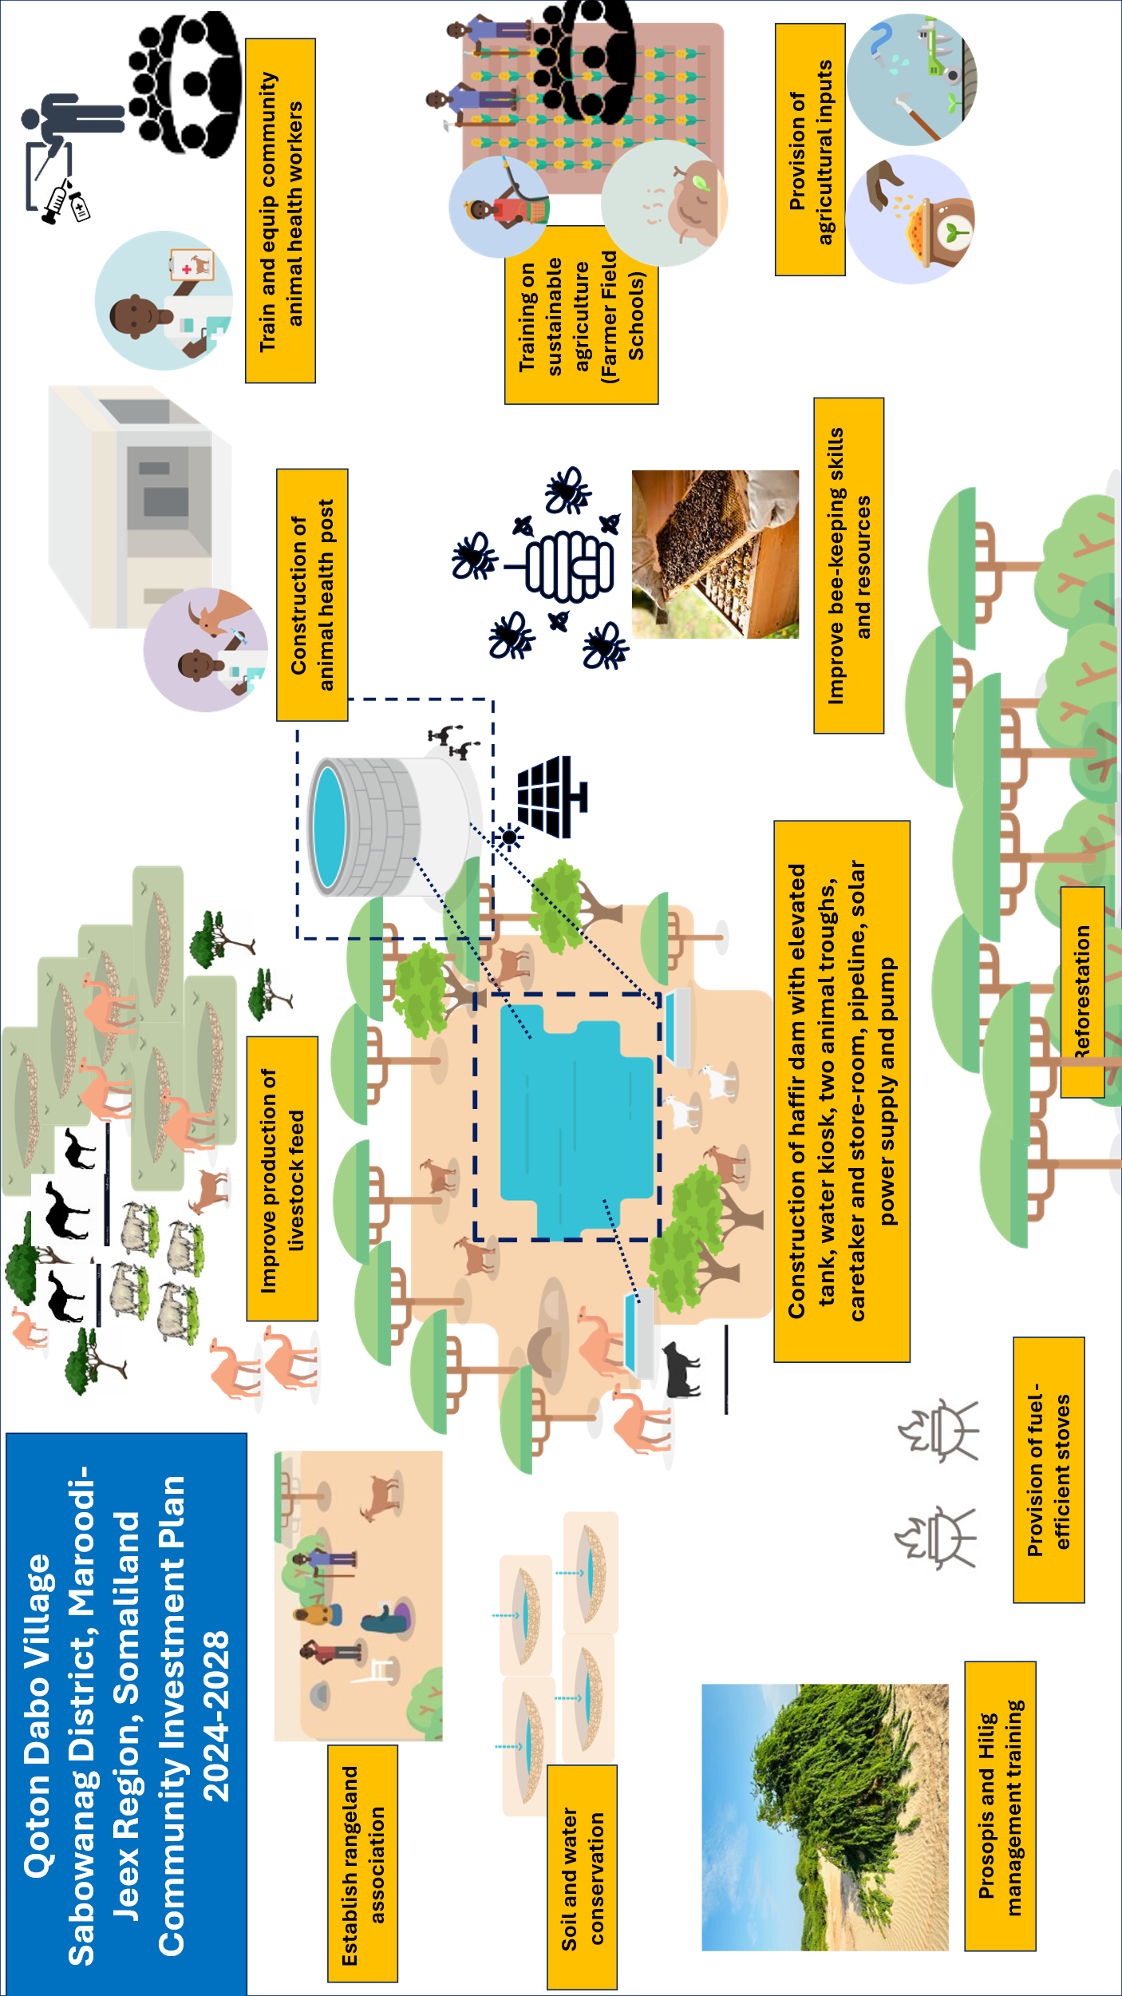
Jaantuska Qorshaha Maalgelinta Tuulada oo Kooban

