Slide 1

Mashrruca Barwaaqo: Baanka Adduunka – Dowladda Somaliland
Qorshaha Horumainta Bulshada 2024—2028
Tuulada Karinshabeel, Degmada Farawayne ee Gobalka Maroodijex
Nidaamka Biyaha: Dhisida Dhaam Biyood Cusub .
Barta Uu Kuyaalo: 20 km Koonfur galbeed Hargaysa. GPS: N: 9.4309 E: 43.9557
Tirada Bulshada: 550 households oo degan ah iyo 250 oo reeguraa biyaha soo doonta xiliyada abaarta.
Tuulooyinka Hoos Yimaada: 0.
Ilaha Dhaqaalaha Muhimka Ah: Xoolo Dhaqato Beeralay ( Geel, Lo,o, Adhi, dameero iyo dhaqashada shinida). Falashada beeraha roobka ku baxa iyo xaagsatotada
Leadership: Village Development Committee of 7 (5 men, 2women), Elders committee.
Aragtida Bulshada
Bulshada Guud: In la gaadho helitaanka biyo joogta ah sanadka oo dahan, iyadoo anay xooluhu anay uhayaamin biyo raadsasho, qoysaskunu ay gadhaan isku filnaasho cuntada, Sidoo kale ubadku helaan dugsi udhow adeegyada cafimaad oo diyaarsan dumarka oo kor looqaday xirfadahooda iyo horumarinta kabayaasha aasaasiga ah ee bulshada Haweenka : In ay arkaan mustaqbalka helitaanka adeeg cafimaadka iyo waxbarashada oo ay si fudud ugadhi karaan. Sidoo kale helitaanka biyo joogta ah sandak oo dhan meelo udhow guryahooda iyo in gabdhaha qaangaadhka ahi ay helaan fursadaha waxbarashada iyo kor uqadista kaalmha dhaqaale. Sidoo kale kor loo qaado fayadhorka degaanla iyadoo la dhisayo suuliyaal . Dhaliyarada Dumar ah: In dhamaan gabdhaha da,da yar ay helaan adeegyo caafimaad iyo waxbarsho oo korlooqaday, sidoo kale ay helaan tobabaro iyo xifrdo ay ku hanan karaan shaqooyin wanagsan iyo fursado badan oo shaqaooyinka ah Dhaliyarada Raga ah: In ay arkaan dhalinyarada tuulda oo la horumariyay iyadoo la siiyay tobaro xifadaha farsmada gacanata iyo tobabarada kaleba, in aanay dhicin biyo yaraan sanadka oo dhan iyo in dhalainyaradu si xor ah ugu ciyaaraan garoomo kubada cagta ah oo casriya.
Arimaha Hortabinta U leh Bulshada
Maamulka Illaha Biyaha | Dhisida dhaam biyood cusub, taangiga kayd, nidaamka tamarta cadceeda, qasabada iyo dararka xoolaha, xaydaab siliga iyo qolka waardiyaha Nidaamka qasabadaha sooqadaya oo qaybinaaya biyaha Tobabarada gudiga maamulka biyaha
Xoolaha iyo Beeraha | Xoolaha Bixinta adeega caafimaadka xoolaha Koruqdista waxsoosaarka calafka xoolaha iyo farsamayntisa Nidaamka dib uxoolaynta qoyasaska Taagerada xaga suuqgaynta canaha ee dumarka caanaha ka shaqaysta Kor uqaadista iyo dhisida awooda iyo xirfada daryeelayaasha caafiaamdka xoolaha Kor uqaadista dhaqashada shinida iyo digaaga Beeraha Helitaanka mishiinada beeraha Maraaynta cayayaanada iyo xanuunada beeraha Helitaanka abuurka midhaha oo tayadisu aad u sarayso. Dhisida iskaashatooyin beeralay
Degaanka | Tobobarada laxidhiidha maamulka khayraadka dabiiciga ah Fulinta shaqooyin lagu ilaalinayo carrada iyo biyha Xakamaynta iyo maamulka geedaha garanwagaa iyo hiliglaha Dhirayn degaanka In shaqo loo abuuro qoysaska ku tiirsan dhuxusha

Slide 2
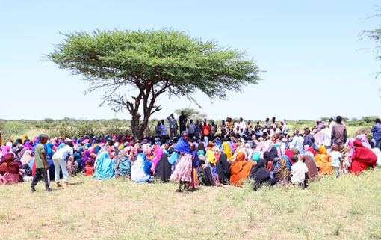
Taariikhda of CIP lafuliyay: 20-23 August 2024
Tirada Dadka Lala Tashaday
7 xubnood oo gudiga tuulada ah (5 raga, 2 dumara)
32 Haweena oo dhalinyarada haweenkuna
16 Dhalinyara(10 ragga 6 dumara)
10 Beeralay (6 raga, 4 dumara)
10 Xoola dhaqato ah (8 raga 2 dumara)
10 gudiga biyaha ah (7 raga, 3 dumara)
260 bulshada guud ah (175 rag, 85 dumar)
Kooxda CIP Ka Fududaysay (29 % ayaa dumar ah):
Qaybta hirgalinta Mashruca Barwaaqo : Isudubarida mashruuca, khabiirka badqabka bulshada, Khabiirka Xagudubyada Jinsiga , Khabirka xidhiidhinta mashruca , Lataliyaha Diyarinta qorshaha horumarinta bulshada iyo sargaalka qorshaha horumarinta bulshada
Khabiirada Ka Socda Wasarada Mashruuca Fuliya: Khabiirada xoolaha, beeraha, degaanka iyo biyaha.
Tuulada Garabis : Gudomiyaha, Gudiga horumarinta Tuulada , iyo Qaybaha kala duwan ee Bulshada ,
Jadwalka Xilli-Taariiikheedka
Goobta: Karinshabeel | Abr. | Maaj | Juun. | Luul. | Ogo. | Sebt. | Okt. | Nof. | Dis. | Jan. | Febr. | Maarj.
Sanadka Xiliyadiisa | Gu’ |  |  | Xagaa |  |  | Deyr |  |  | Jiilaal
Roobka | X | XX | X | XX |  |  | X X | X | X
Xilliga xooluhu Rimaan |  |  |  |  |  |  |  |  | X | X | X | X
Xilligu ay xooluhu dhalaan | X | XX
Wakhtiyada calafka La Heli Karo | XX | XX | X | X | X |  | XX | X | X | X
Wakhtiyada Canaha iyo Subaga la heli karo |  | XX | X |  |  | X | XX | XX
Xiliyada Ugu fican Iibka Xolaha | XX | XX | XX | X | X | X | X | X | X | X | X | X
Wakhtiyada xooluhu ka hayaaman degaanka |  |  |  |  |  |  | X |  |  |  |  | XX
Wakhtiyada Cudurada xoolaha badan yihiin |  |  |  | X | X |  |  |  |  | X | X | XX
Xilliyada Gaajada |  |  |  |  |  |  |  |  | X | X | X
Wakhtiyada Cudurada dadka ku dhaca ay badan yihiin |  |  | X | X |  |  |  |  |  | X | X | XX
Wakhtiyada la beero dalagyada daruuriga ah |  |  |  |  | XX |  |  |  |  |  |  | X
Xiliga goosashada beeraha |  | X |  |  |  |  |  |  | X
Xilliyada guurka Badan yahay | X | XX |  |  |  | X | XX | X |  |  |  | X
Xilyada Wax aad Loo Amaahdo |  |  |  |  |  |  |  |  |  | X | X | X
Wakhtiyada Iskoolka La dhigto | X | X | X |  |  | X | X | X | x |  | X | X

Slide 3
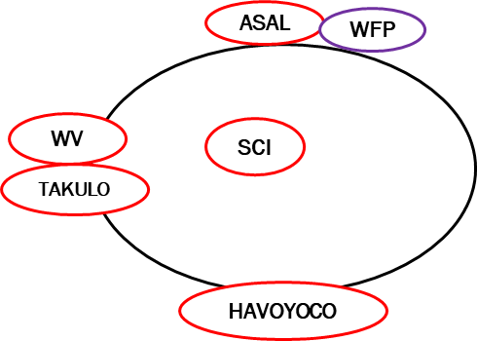
Hayadaha/Ururada Tuulada Ka Shaqeeya
Ururka amma Hayada lad | Shaqooyinka Muhimka ah
Hayada Cuntada Aduunka /ASAL | Taageero maaliyadeed, cunto
HAVOYOCO | Dhisida moosaska ka hortaga carro guurka
Hayada Badbaadada Caruurta | Tobabarista 1 kalkaaliye caafimaaad iyo qaybinta buskudaka nafaqada caruurta
World Vision/ Dutch Relief Allaience | Dhimaha hal Barked biyood

Slide 4
Howlaha Waxqabad ee Laga Maalgalinayo Mashruuca Barwaaqo
Howlaha waxqabad | Faahfahinta Waxqabadyada (quantities, hectares…)
Dhismaha Dhaam Biyood Cusub | Dhismaha Dhaam biyood cusub oo leh cabirka 40m balaca, 40m dhererka iyo 3.16 m oo joog ah, kasoo la dhigayo qarbidka biyaha haya. Samaynta kayd kor loodhisay, qasabadaha biyaha laga cabo, 1 dararka xoolaha, qolalka waardiyaha iyo ka alaabta lagu kaydiyo iyada biyaha looga soo saarayo nidaamka tamarta cadceeda Tobabarka gudiga maamulka biyaha
Adeega caafimaadka xoolaha | In lasiiyo 1 mooto daryeelayaasha caafimaadka xoolaha
Dib uxoolaynta qoysaska nugul | Doorashada qoysaska lasiinayo xoolaha, soo iibinta iyo qaybinta 450 neef oo adhi ah iyo 30 dameero ah
Kor uqaadista soosaarista calafka xoolaha | In la dhiso lana tobabaro iskaashatada soo saarista calafka xoolaha lagana taagero tobabaro la xidhiidha kor uqaadista waxsoosaarka xoolaha iyo farsamayntisa
Kor uqaadista xirfadaha dhaqashada shinida iyo khayraadka | Soo iibinta iyo qaybinta sanaaduuqda shinida, galoofisyada,qiijiyaha iyo dhamaan agabyada kale ee loo isticmaalo shini dhaqashada. Qalbkaa oo loo qaybiyo 20 qoys oo ah qoysaska nugul; kuwaas 8 kamida ay hogaminayaan dumar. In la siiyo tobabaro la xidhiidha dhaqashada shinida, goosashada malabaka iyo dayactirka sanduuqyada shinida
Tageerada agabka waxberashada | Soo iibinta iyo taageerada abuur tayadisu sarayso, tobabaro laxidhiidha hababka wanagsan ee waxberashada, taagerada agabka lagu maareeyo cayayanada iyo xanuunada beerah iyo qaybinta agabka waxsoosaarka beeraha oo lasiiyo 90 beeralay
Hababka Ilaalinta Caradda iyo Biyaha | In la dhiso Moosaska ilaaliya carrada iyo biyaha oo dhararkodu yahay 12,800 (udhiganta 60 hiktar), 80 m3 oo biyo-xidhenada dhagaxa ah( udhiganta 12 hiktar) iyo 90 m3 oo moosaska dhagaxa ah (u dhiganta 15 hiktar)
Dhisida iskaashato beeralay | Dhisida iyo toabarida iskaashato beeralay iyo inloo samaeeyo hagaha iyo xeerhoosaadka iskaashatada
Dhisida xarun lagu isugu keeno caanaha | In ladhiso1 xarun oo la isugu keeno caanaha oo leh qaboojiye ku shaqaynyna nidaamka tamarta cadceeda. In la isu dubarido oo laga dhigo iskaashato dumarka ka sahqeeysta suuqgaynta caanaha , sidoo kalana loo qaybiyo agabka nadaafada caanaha loo isticmaalo
Kor uqaadista dhaqashada digaaga | Soo ibinta iyo qaybint nooca digaaga adkaysiga u leh cimilada adag, iyo loo dhiso guryaha digaaga oo casri ah, meelaha ay ku xerodaan, quudiyayaal, iyo melaha ay biyaha ka cabayaan In lasiiyo tobabaro itusoo u=itaabsi ah oo ku saabsan dhaqashada digaaga
Ilaalinta dhirta iyo dhiraynta | In la dhiso lana tobabaro urur ilaaliya dhirta iyo dhul daaqsimeedyada In la beero 2000 oo geed oo geedaha degaan u aslka ah
Taageerada girgirayaasha tamarta madhxiya | In loo qaybiyo 115 qoys girgiyaasha tamarta madhxiya
Tobabar Maaraynta khayraadka dabiiciga ah | Diyaarinta hagaha tobabarka, doorashada ka qayb galayaasha iyo bixinta tobabarka lagu bixinata xarunta bandhiga

Slide 5
Howlaha kale ee hortabinta u leh tuulada: maalgelinta looga raadinaayo mashruucada kale
Caqabadaha Gaarka Ah | Waxa Loo Bahanyahay in Laga Qabto
Helitaanka Adeeg waxbarasho | In la dhiso, lagana sahqaysiyo dugsi sare
Hleitaanka tobabarada xirfadaha | In dhalinyarta loo abuuro fursado ay uga qayb gali karaan tobabarada casharada xirfadaha farsmada gacanta
Jiritaan la,aanta adeeg caafimaad oo udhow | Qalabaynta xarunta dhalaanka iyo hooyada, tageerada dawwoynka iyo shaqaalaha xarunta
Jiritaan la,aanta adeegyada fayadhowrka | Dhismaha suuliyaal loo dhiso qoysaska nugul

Slide 6
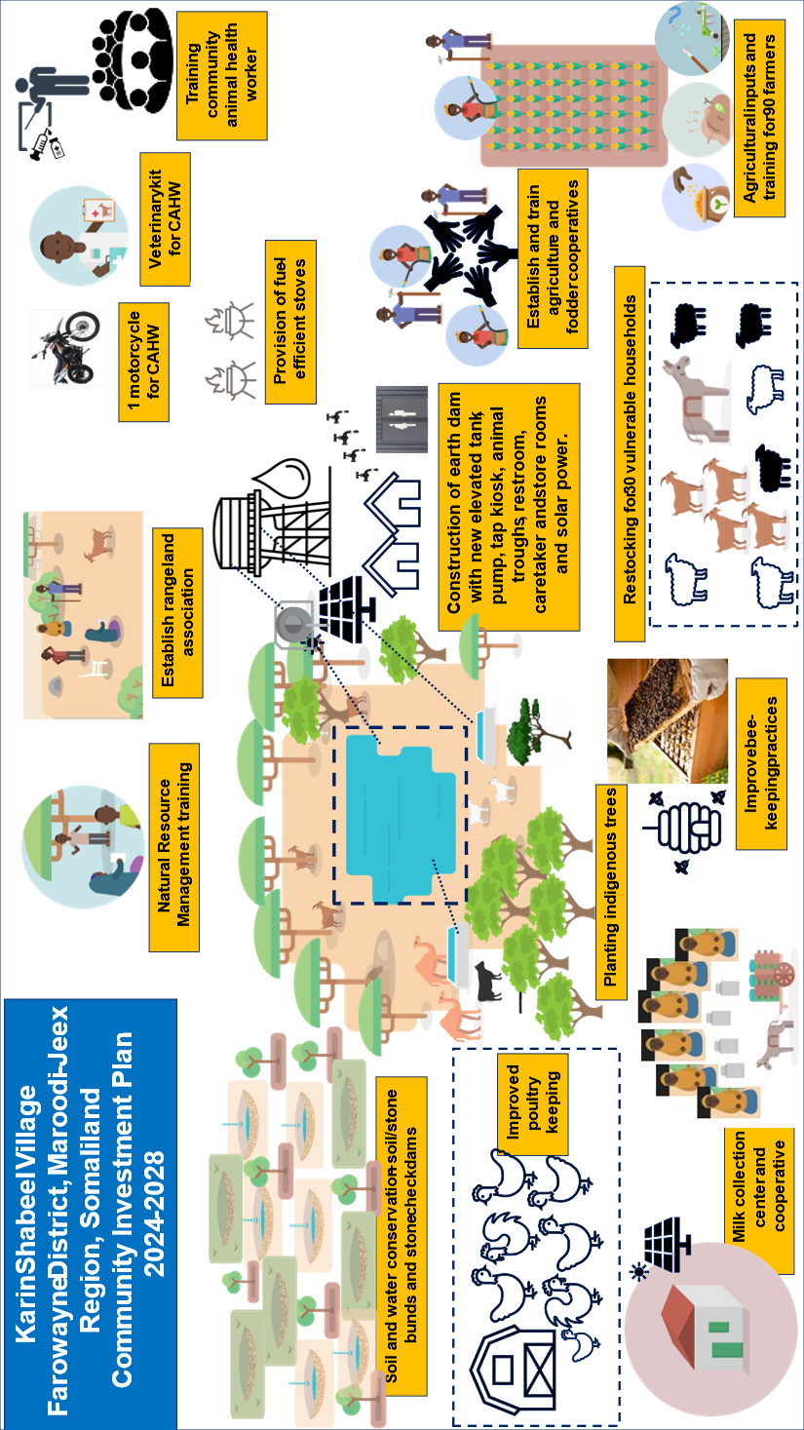
Jaantuska Qorshaha Maalgelinta Tuulada oo Kooban

