Slide 1

Barwaaqo Project: World Bank - Government of Somalia / Somaliland
Qorshaha Horumarinta Bulshada 2024-2028
Tuulada Holhol, Degmada Borama.
Barta Biyaha: Dayactirka Dhaamka Biyaha ee Holhol
Goobta oo ku yaalo: 4km ka xigaa galbeeldka Borama. GPS: N: 09.9159 E: 043.14202
Tirada Bulshada : 250 Qoys. Tuulooyinka Hoos Yimaada:50 degsiimo
ILLAHA Dhaqaalaha: Xoolo dhaqato beeroley: Geel, Lo’, Adhi, Caanaha, Subaga, Beedka , Malabka, Xasiida, qamadiga, massagada, digirta , tamaandhada
Maamulka : Guddiga Horumarinta Tuulada (4 Nin, 3 Dumara); Guddi Nusdanbeed ah (Rag iyo dumarba leh).
Hiigsiga Bulshada (Community Vision)
Hiigsiga laga siman yahay: Deegaan cagaaran, nadiif ah, caafimaad leh biyahana sanadka oo dhan la helayo,wax soosaarka dalaga iyo xoolaha ee unugkastaa kordho. Hiigsiga Haweenka: Daryeelka caafimaadka hooyada iyo dhalaanka oo hagaagay, cunto soosaarka oo la horumariyay iyo helida biyo nadiifa Dhalinyarta (Lab iyo Dhedig): Xirfadaha dhalinyarta oo la horumariyay,and fursado shaqo oo la abuuray. Hiigsiga Dadka Naafada ah: Helitaanka baahiyaha u gaarka ah wax u fududeeya, si firfircoona uga qayb qaataan go’aanada Bulshada.
Baahiyaha Ugu Muhiimsan Ee Bulshada (Community Priorities)
Maamulka Illaha Biyaha | Dib u hagaajinta dhaamka oo ay ku jirto caro reeb iyo Dayr ama xayndaab Xoojinta awooda guddiga biyaha oo ay ku jirto tabobarada maaraynta maaliayadda.
Xoolaha & Beeraha (Livestock & Agriculture) | Xoolaha (Livestock) Horumarinta helida adeega caafimaadka xoolaha U hawlgalka waxyaabaha qiimaha u yeelaya xoolaha, Kordhinta caanaha iyo subaga laga helo lo’da iyo adhiga Beeraha (Agriculture) Xal u helida caro guurka beeraha Helista iniin tayo leh, bacrimayayaal iyo qalabka gacanta ee beeraha. Samaynta iskaashatada Beeraleyda. Xayndaab silig(taar) ah oo loo sameeyo beeraha. Kordhinta awooda lagu xakamaynayo cayayaanka iyo cudurrada. Kordhinta mashiinada lagu farsameeyo beeraha.
Deegaanka (Environment) | Joojinta caro guurka ay samaynayaan biyo-mareenadu Ku tabobarida Bulshada ilaalinta carada iyo biyaha. Soo celinta dhul daaqsimeedka. Joojinta xaalufinta ka dhalatay dhuxulaysiga.

Slide 2
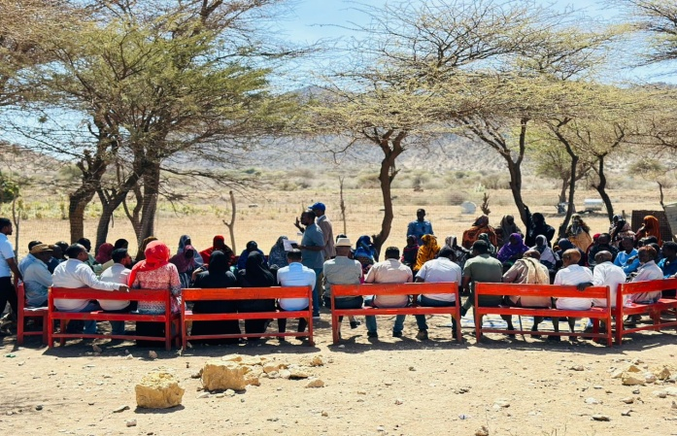
Date of CIP discussions: 24-27 February 2024
Number of people consulted
7 xubnood oo gudiga ah (4 rag, 3 Haween)
36 Haweena
14 Dahlinyaro (9 Ragg, 5 Dumar)
1 Qof oo bahiya gaarka ah qaba
13 Beeralay (9 Ragg, 4 Haween)
12 Xoolo Dhaqato (7 Ragg, 5 Haween)
11 Guddiga Biyaha (7 Ragg, 4 Haween)
92 Kulanka Bulshada Guud (58 Ragg, 34 Haweena )
CIP facilitation team (21% Haween):
Qaybta hirgalinta Mashruca Barwaaqo, Khabirka xidhiidhinta mashruca , Lataliyaha Diyarinta qorshaha horumarinta bulshada, sargaalka qorshaha horumarinta bulshada iyo abaabulka bulshada
Khabiirada Ka Socda Wasarada Mashruuca Fuliya: Khabiirada xoolaha, beeraha, degaanka iyo biyaha.
Tuulada Geed abeera : Gudomiyaha, Gudiga horumarinta Tuulada , iyo Qaybaha kala duwan ee Bulshada ,
Jadwalka Xilli-Taariiikheedka
Goobta: Holhol | Abr. | Maaj | Juun. | Luul. | Ogo. | Sebt. | Okt. | Nof. | Dis. | Jan. | Febr. | Maarj.
Sanadka Xiliyadiisa | Gu’ |  |  | Xagaa |  |  | Deyr |  |  | Jiilaal
Roobka | X | ^{X} |  | XX | XX | X |  |  |  |  |  | X
Xiliyada Biyaha Lahelo |  | X | X | X | X | X | X | X
Xiliyada Cuntada la helo |  |  |  |  | X | X | X | X | X | X | X
Wakhityada ay badab yihiin Xanuunada Xooluhu | XX | XX | X | X |  |  |  |  |  | X | X
Xiliyada Xanuunada iyo Cayayaanada Dalagu Badan yihiin |  |  | X | X |  | X | XX
Xiliyada Ugu fican Iibka Xolaha | XX | XX |  |  |  |  |  | X | X |  | X | X
Xiliyada Iibka Caanuhu Fican yihiin | X | X | X | X | X | X | X | X | X | X | X
Xiliyada La helo Shaqaalaha Xoogsatada |  |  |  |  |  | X | X
Xiliyada Calafka Xoolaha La helo |  |  |  |  |  |  |  |  | X | X | X
Wakhtiyada la beero dalagyada daruuriga ah |  | X | XX |  | X
Xiliga goosashada beeraha |  |  |  | X |  |  |  |  | X | X
Xilliyada Xanuunada Dadku Badan yihiin |  | X |  |  |  |  | X | X
Xilyada Guurka iyo ducooyinku Badan yihiin | X |  |  |  |  |  | X | X |  |  |  | X

Slide 3
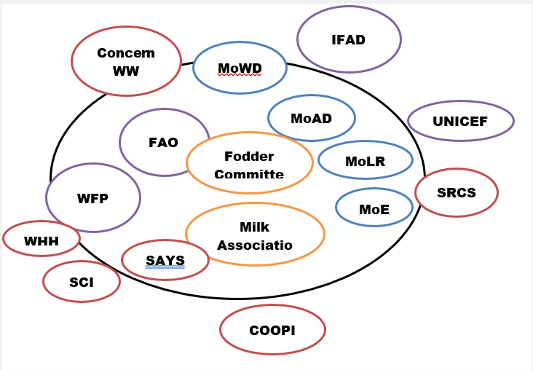
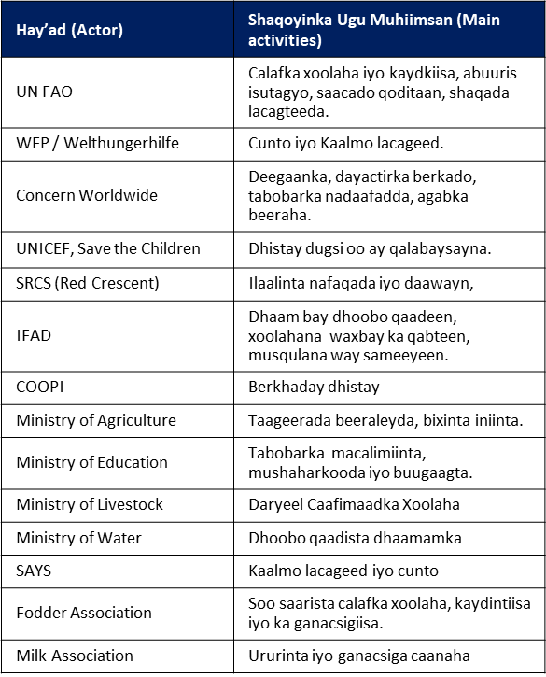
Hay’addaha Ka Hawlgala Amma Siiya Taakulo Bulshada Tuulada

Slide 4
Waxqabadyada uu Maalgelinayo Mashruuca Barwaaqo
(Activities to be funded by the Barwaaqo Project)
Waxqabad (Activity) | Faahfaahinta Waxqabadka(Activity detail)
Dayactirka dhaamka deegaanka | Dhoobo qaadis, deyr u samayn, dhismaha taangi dhulka yaala, qasabadaha laga dhaansado, iyo dararka xoolaha.
Adeegyada Caafimaadka Xoolaha | Tabobarka Shaqaalaha caafimaadka xoolaha. Xoolaha oo la talaalo lana daaweeyo.
Tabobar ku saabsan maaraynta cudurrada iyo cayayaanka. | Tabobar ku saabsan cudurrada faafa ee xoolaha.
Samaynta Guddi hoosaad horumarinta tuulada | Xulashada , dhexgalka iyo tabobarka xubnaha Horumarinta guddi hoosaadka , usamaynta qaab dhismeed iyo xeer hoosaad
Samaynta Iskaashatada Caano-diiqda. | Bixinta joogadaha caanaha/qalab iyo tabobar ku saabsan ilaalinta nadaafadda caanaha.
Bixinta Agabka Beeraha | Bixinta iniinyo tayo leh, bacrimayayaal iyo qalab la siinayo 30 qoys, bixinta iyo rakibidda taandhooyinka dhirta lagu koriyo iyo bixinta 4 bacda biyaha xejisa.
Samaynta Iskaashatada beeraleyda. | Bixinta tabobar ku saabsan casriyaynta cimilada beeraleyda (4 Beeroley ah oo kooxaha dugsiyada ah).
Soo celinta dhul daaqsimeedka | Xidh Xidhka Carada (7ha coverage), 98m³ dhagax difaac unoqda dhaamka, 108m³ oo gabyan ah iyo 27m³ oo dhagax iyo ciid ah.
Tabobarka ilaalinta carada iyo biyaha | Tabobar bixiye,qalabka tabobarka iyo buug-gacmeedyada.
Dhirayn | Beerista 4000 geed oo dhirta wadanka ah
Bixinta Shooladaha gaasta ku shaqeeya | Qoysaska danyarta ah oo loo qaybiyo shoolado
Samaynta ururka dhul daaqsimeedka | Abuurida and tabobarka urur maareeya dhul daaqsimeedka.

Slide 5
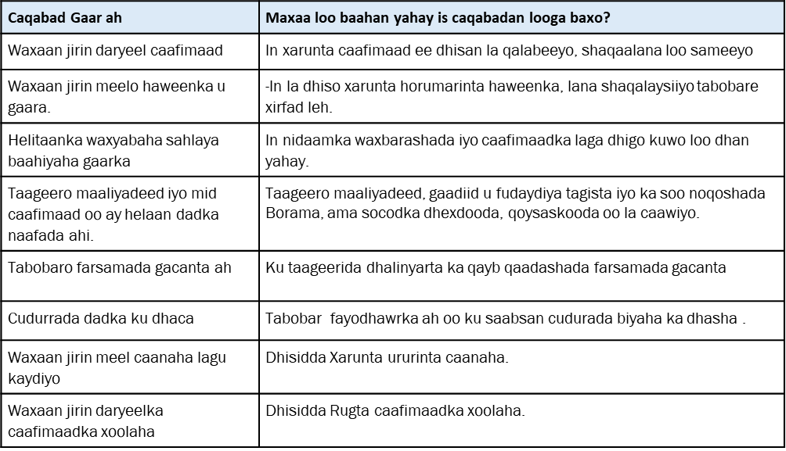
Baahiyaha Kale ee Bulshada ee ay Tahay in Mashaaricaha kale laga Maalgeliyo.

Slide 6
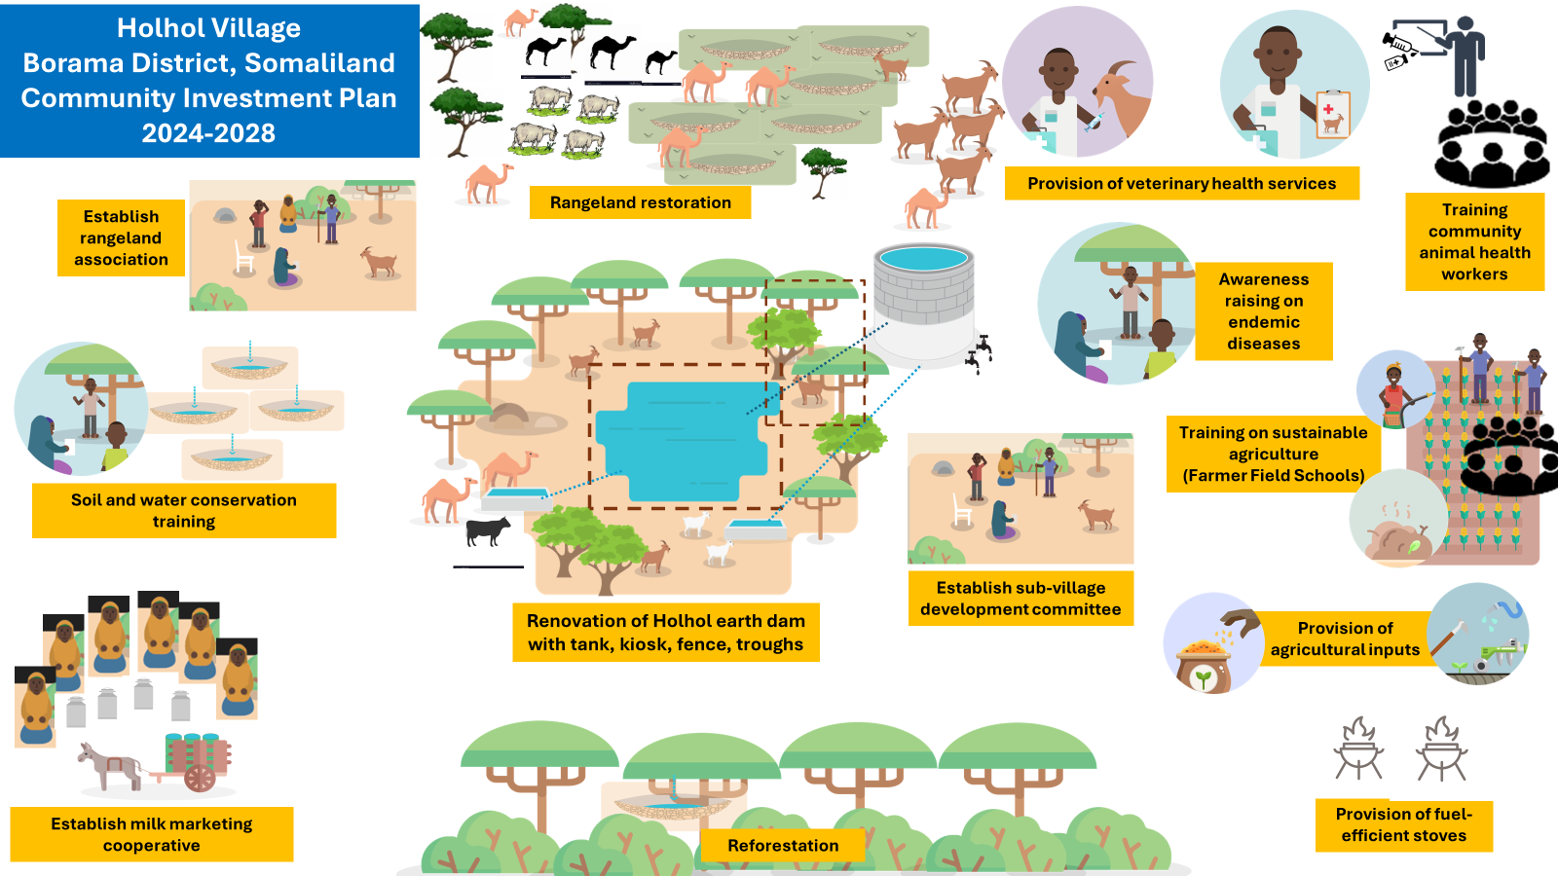
Jaantuska Qorshaha Maalgelinta Tuulada oo Kooban

