Slide 1

Barwaaqo Project
World Bank - Government of Somaliland
Qorshaha Horumarinta Bulshada 2024-2028
Tuulada Gumburaha, Degmada Baligubadle,
Maroodi-Jeex Region.
Barta Biyaha: Dhaam Biyood.
Goobta: 40km Koonfurta Hargeysa. GPS: Latitude: 9.1797°, Longitude: 44.0208°
Tirada Bulshada : 1250 qoys oo lagu daray 500 qoys oo reer guuraa. Tuulooyinka Hoos yimaada: 4
Ilaha Dhaqaalaha : Beeraha iyo Xoolaha,
Maamulka (Hogaanka ): Guddiga Horumarinta Tuulada (5 nin , 2 Haweena)
Hiigsiga Bulshada (Community Vision)
Hiigsiga Guud ee Bulshada : In la helo biyo sanadka oo dhan iyadoo la dhisayo dhaam biyood,caafimaadkii iyo baadkii xoolahana la horumariyay,deegaankuna noqday xudunta wax soosaarka,sidoo kalana la helay daryeel caafimaad,waxbarashana caruurta looga helay tuulada dhexdeeda iyo seerihii oo la soo celiyay iyadoo la maray talaabooyinka wax ku ool ah oo lagu ilaalinayo Kaymaha. Hiigsiga Haweenka: Sanadka oodhan oo ay helaan; biyo, daryeel caafimaad,waxbarasho,laydh ama koronto iyo iyadoo kor loo qaaday waxsoosaarka iyo xoolaha. Sidoo kalana la arko haweenkii awood yeeshay dhaqaale ahaana sareeya. Hiigsiga Haweenka Dhalinyarta ah; waxay hiigsanayaan Tuulada oo laga helo biyo nadiifa, waxbarasho tayo sare leh, daryeel caafimaad oo la isku halayn karo iyo dhamaan kaabayaasha casriga ah. Sidoo kalana iyadoo kor loo qaado warcyigelinta ku saabsan tacadiyada dumarka loo gaysto. Hiigsiga Dhalinyarta Wiilasha ah; Dhalinyarta tuulada oo noqotay ku leh xirfado kala duwan, deegaankoodana laga helo biyo guryaha soo gaadha,laydh, wadadii oo la hagaajiyay. Islamarkaana aanay jirin cid iskuula joojisa..
Baahiyaha Ugu Mudan ee Bulshada (Community Priorities)
Maamulka ilaha biyaha (Management of water sources) | Dhisidda dhaam leh taangi sare, dararkii xoolaha Xayndaab ama Dayr loo sameeyo Dhaamka In la dhiso Qolka ilaalada iyo Qol alaabta la dhigo Dhuumaha biyaha gudbinaya iyo kuwa laga cabayaba Rakibidda Soolar biyaha soo tuura In tabobar la siiyo guddiga maaraynta biyaha.
Xoolaha Iyo Beeraha (Livestock & Agriculture) | Xoolaha (Livestock) In la kordhiyo adeegyada caafimaadka xoolaha. Dib u xoolaynta qoysaska nugul Kor u qaadista aqoonta shaqaalaha caafimaadka xoolaha Taageerida dumarka caano-diiqda ah. Taageerida Maalgashiga digaaga. Beeraha (Agriculture) In la helo bacaha biyaha u qabta beeraha, si loo qoto Tabobar ku saabsan xirfadaha iyo farsamooyinka wax soo saarka cuntada. Helitaanka iniinyo tayo sare leh iyo agab In la helo saacadaha beerashada Rakibidda taandhooyinka lagu koriyo dhirta.
Deegaanka Environment | Hirgelinta ilaalinta ciidda iyo biyaha Xakamaynta iyo maaraynta dhirta soo duulayaasha ah Tabobarka Maaraynta Khayraadka Dabiiciga ah.

Slide 2
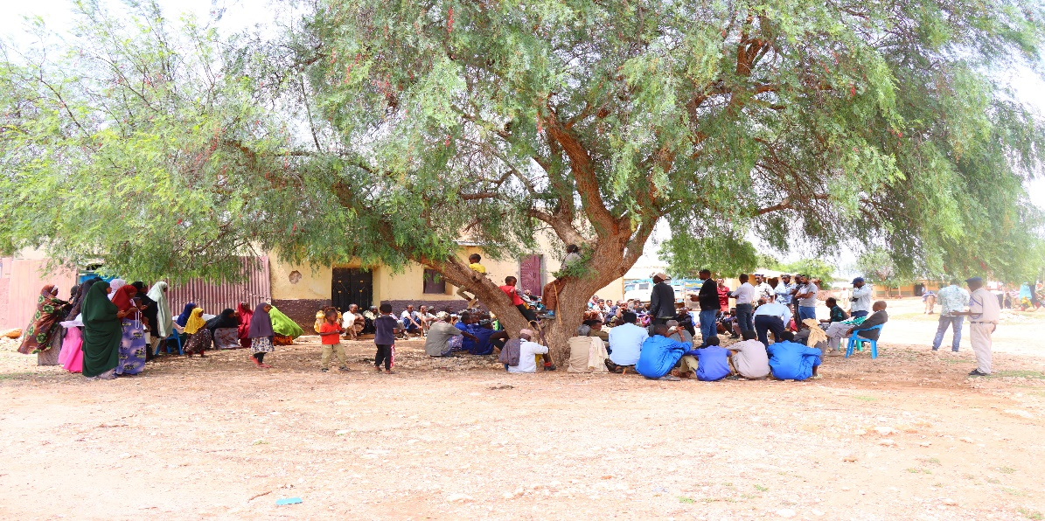
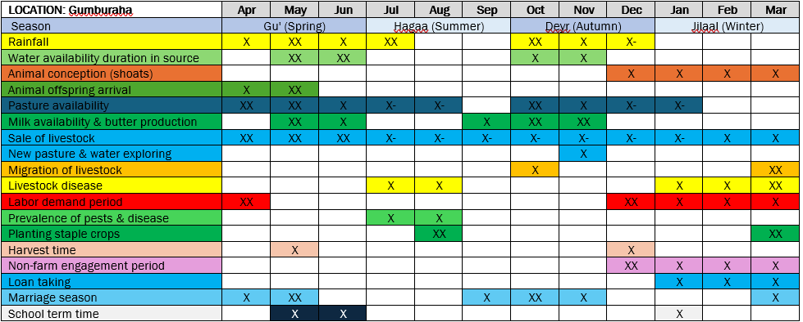
Date of CIP discussions: 9-12 August 2024
Tirada Dadka La Xogwaraystay
7 Guddiga Horumarinta (7 Nin, 0 Haween)
18 Haweena
9 Dhalinyar ah (5 Wiil, 4 Hablood)
7 Beeraley ah (5 Nin, 2 Dumara)
10 Xoolo dhaqato ah (7 Nin, 3 Dumara)
7 Guddiga biyaha ah (6 Nin, 1 Gabadh)
92 Tirada guud ee kulanka ka soo qayb gashay (74 Nin, 18 Dumara)
Kooxda fulisay qorshaha Horumarinta (10% Haween ahaa):
Barwaaqo PIU: M&E Specialist, Technical Officer, Communications, Local CIP Consultant, Intern.
Somaliland Line Ministry Specialists: Water resources, Agriculture, Environment, Rangelands.
Jaantuska Xilliyada (Seasonal Calendar)

Slide 3
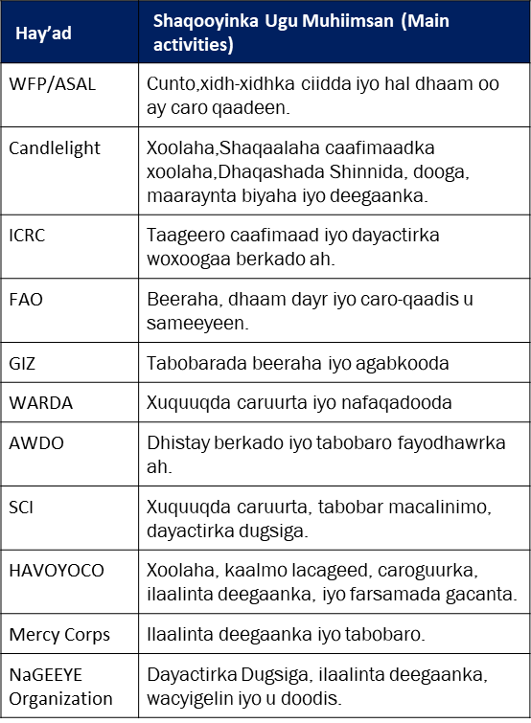
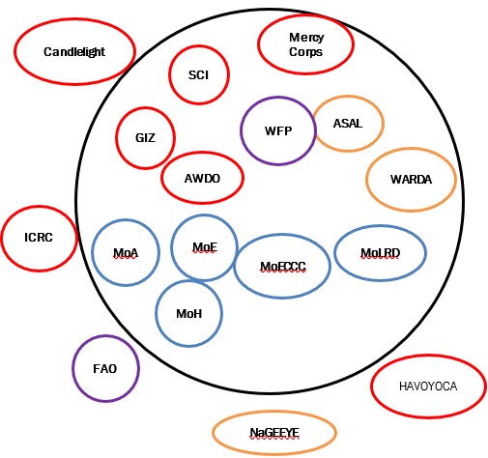
Hay’adaha Ka shaqeeya amm ufidiya Taakulo Bulshada

Slide 4
Shaqooyinka Uu Maalgelinayo Mashruuca Barwaaqo
(Activities to be funded by the Barwaaqo Project)
Shaqada (Activity) | Faahfaahinta Shaqada (Activity detail)
Dhismaha Dhaamka (Construction of Haffir dam) | Dhismaha iyo xayndaabka Dhaam Cabirkiisu yahay 75 m x 85 m Baladh ahaan, 2.50 m uu hoos u qodan, taangi sarana leh, meelaha biyaha laga dhaansanayayna leh, laba dararka xooluhu ka cabaan, qolka ilaaliyaha iyo qolka kaydka alaabta. Rakibidda dhuumaha biyaha oo leh tamarta cadceeda(solar) biyaha soo tuura. Tabobarka guddiga maaraynta biyaha.
Adeegyada Caafimaadka Xoolaha | Kor u qaadista iyo casriyaynta aqoonta shaqaalaha caafimaadka xoolaha ee deeganka hore uga jiray,daawooyinka xoolaha. Laba Mooto oo ay shaqaalaha caafimaadka xooluhu isticmaalaan.
Dib u Xoolaynta Qoysaska Danyarta ah | Usoo iibinta 300 neef oo adhi yar yar ah iyo 20 dameer qoysaska danyarta ah ama nugul. Rarida iyo qaybinta xoolahaa la soo iibiyay.
Dhismaha Xarumaha Ururinta Caanaha & horumarinta Qiime u yeelidooda. | Dhisidda xarunta caano ururinta oo leh tamarta cadceeda(Solar) iyo qaboojiye(Talaajad), joogaga caanaha iyo agabka kale ee caanaha. Uqaabaynta caano-diiqda sida iskaashatada.
Horumarinta Digaaga (Poultry improvement) | U helida cimilo horumarsan oo digaagu u adkaysan karaan. Dhisidda guri digaag oo casri ah, oo leh sanduuqyada quudinta iyo biyo cabinta. Tabobar wax ku ool ah oo ku saabsan maaraynta digaaga.
Agabka Beeraha iyo tabobaro (Provide agricultural inputs and training) | Bixinta iniin tayo sare leh, agab, Rakibidda 5 taandhooyinka dhirta lagu koriyo ah, tabobar beeraha oo fulin leh(practical), agabka maaraynta cayayaan iyo cudurrada oo la siiyo isuggayn 50 Beeroley ah.
Hababka Ilaalinta Ciida iyo Biyaha (Soil and water conservation practices) | Dhismaha 16,000 LM oo xidh-xidhka carada (55 ha); 200 m³ oo Dhagax difaac u ah dhaamka laguna daboolay (7 ha) and 80 m³ oo qaab dhagax ah kuna gaadhaysana 5 ha.
Xakamaynta Dhirta Duulaanka ah (Invasive species control) | Tabobar ku saabsan geedka garanwaaga, qalabka tabobarka iyo buug gacmeedyada.
Ilaalinta Kaynta (Forest protection) | Samaynta Ururka Seeraha.
Tabobarka Maaraynta Khayraadka Dabiiciga ah (NRM Training) | Diyaarinta buug gacmeedka tabobarka iyadoo tabobarka gacanta laga fulinayo goobtana lagu soo bandhigo.
Bixinta Shooladaha Gaasta ku Shaqeeya | U qaybinta shooladaha gaasta ilaa 150 Qoys.

Slide 5
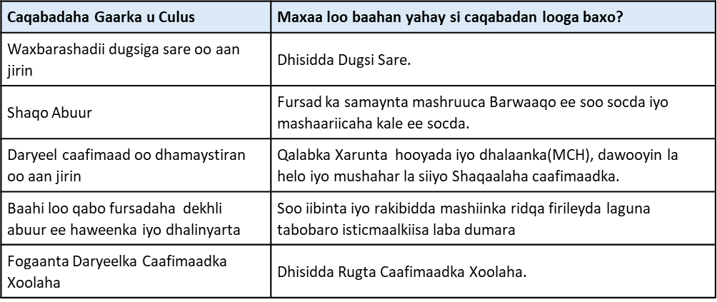
Baahiyaha Kale ee Bulshada Ee Mashaariicaha Kale Laga Rabo
(Other Community Priorities: funding to be sought from other) projects

Slide 6
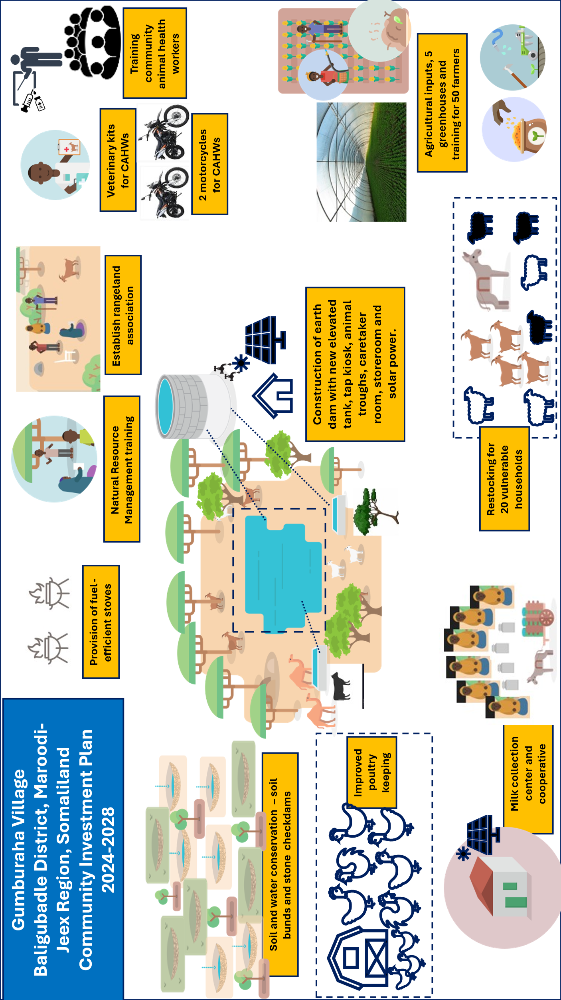
Summary Diagram: Activities to be implemented by Barwaaqo

