Slide 1

Mashrruca Barwaaqo: Baanka Adduunka – Dowladda Somaliland
Qorshaha Horumainta Bulshada 2024—2028
Tuulada Geed Abeera, Degmada Gabilay ee Gobalka Maroodijex
Nidaamka Biyaha: Dhisida Dhaam Biyood Cusub .
Barta Uu Kuyaalo: 42 km Koonfur galbeed Hargaysa. GPS: N: 9.5200 E: 43.6996
Tirada Bulshada: 5,000 households oo degan ah oo ay kujiraan tuulooyink hoos yimada
Tuulooyinka Hoos Yimaada: 13.
Ilaha Dhaqaalaha Muhimka Ah: Xoolo Dhaqato beeralay ( Geel, Lo,o, Adhi, dameero iyo dhaqashada shinida) iyo isticmaal beero robaadka waxany beertaan midhaha sida; garow, digirta, tomato iyo qajida.
Leadership: Village Development Committee of 11 (11 men, 0 women), Elders committee.
Aragtida Bulshada
Bulshada Guud: Tuulada geed abeera oo sanadka oo dhan biyaha laga helaayo lagana cidhib tiray baahida biyaha ee dadka iyo xooluhu uga hayamaan tuulada. Sidoo kala caruurtu ay helaan waxbarasho iyo adeeg caafimaad oo marwalba diyaara, waxsoosaarka beeraha oo kordhay, iyo haweenka oo si mug leh uga qayb qaadanayada dhamaan qaybaha waxsoosaarka oo ay kujiraan inay suuqa geyaan waxsoosaarka. Haweenka : In ay sanadkoo dhan helaan biyo joogto, daryeelka cafimaadka iyo waxbarashada oo kor loo qaaday. Sidoo kale in la xoojiyo ganacsiga la xidhiidha xoolaha iyo beeraha iyadoo kor looqaadyo xirfadaha waxsoosaar iyo suuq gaynta ee haweenka. Dhaliyarada Dumar ah: In ay arkaan tuulada oo horumarsa, haystana biyo nadifa sanadka oo dhan, haweenka da,da yar oo la horumariyo iyadoo lasinaayo waxbarasho tayadeedu sarayso, horumarinta xirfadaha, adeeg caafimaad oo dhamaystiran, in la tirtiro ka hadhida dugsiga ee uu sababo guurka dagdaga ah, sidoo kale uu degaankoodu k andiif noqdo geedka granwaaga. Dhaliyarada Raga ah: In ay arkaan dhalinyarada tuulda oo si firfircoon uga qayb qaadanasa horumarka bulshada iyadoo tuuladuna ay leedahay biyo joogto ah, waxbarasho dugsi sare, adeeg caafimaad oo dhamaystiran iyo tobabaro nidaamyada waxsoosaar ee xoolaha iyo beeraha, sidoo kalana ay wakhti uhelaan ciyaaraha
Arimaha Hortabinta U . leh Bulshada
Maamulka Illaha Biyaha | Dhisida dhaam biyood cusub oo xayndaab siliga, taangiga kayd, nidaamka tamarta cadceeda, qasabada iyo dararka xoolaha, iyo qolka waardiyaha Dhisida iyo tobabarada gudiga maamulka biyaha
Xoolaha iyo Beeraha | Xoolaha Adeega caafimaadka xoolaha Koruqdista waxsoosaarka calafka xoolaha iyo kaydintiisa Dib u xoolaynta qoysaska nugul Kor uqaadista dhaqashada digaaga Taageerada iyo horumarinta ka ganacsiga caanaha iyo waxsoosaarka canaha la xidhiidha Taageerada iyo hormainta dhaqashada shinida Beeraha Helitaanka abuur tayadisu sarayso iyo qalb gacmeedka beraha Maaraynta iyo xakamaynta xanuunada iyo cayayaanada beeraha Tobabaro la xidhiidha beeraha In la sameeyo xarun lagu kaydiyo abuurka beeraha
Degaanka | Tobabar maamulka khayraadka dabiiciga ah Fulinta farsamooyinka lagu joojiyo/ maamulo carrada iyo biyaha Xakamaynta iyo maaraynta geedaha ku faafa degaanka

Slide 2
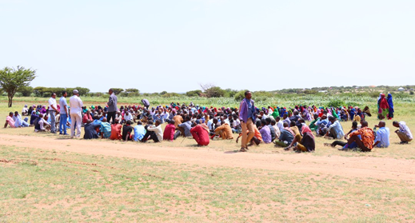
Taariikhda of CIP lafuliyay: 15-18 Agust 2024
Tirada Dadka Lala Tashaday
11 xubnood oo gudiga tuulada ah (11 raga, 0 dumara)
53 Haweena
34 Dhalinyara (11 raga, 23 dumara)
12 Beeralay (7 raga, 5 dumara)
8 Xoola dhaqato ah (5 raga 3 dumara)
9 gudiga biyaha ah (5 raga, 4 dumara)
340 bulshada guud ah (222 rag, 118 dumar)
Kooxda CIP Ka Fududaysay (10 % ayaa dumar ah):
Qaybta hirgalinta Mashruca Barwaaqo, Khabirka xidhiidhinta mashruca , Lataliyaha Diyarinta qorshaha horumarinta bulshada, sargaalka qorshaha horumarinta bulshada iyo abaabulka bulshada
Khabiirada Ka Socda Wasarada Mashruuca Fuliya: Khabiirada xoolaha, beeraha, degaanka iyo biyaha.
Tuulada Geed abeera : Gudomiyaha, Gudiga horumarinta Tuulada , iyo Qaybaha kala duwan ee Bulshada ,
Jadwalka Xilli-Taariiikheedka
Goobta: Geedabeera | Abr. | Maaj | Juun. | Luul. | Ogo. | Sebt. | Okt. | Nof. | Dis. | Jan. | Febr. | Maarj.
Sanadka Xiliyadiisa | Gu’ |  |  | Xagaa |  |  | Deyr |  |  | Jiilaal
Roobka | X | XX | X | XX |  |  | X X | X | X
Xilliga xooluhu Rimaan |  |  |  |  |  |  |  |  | X | X | X | X
Xilligu ay xooluhu dhalaan | X | XX
Wakhtiyada calafka La Heli Karo | XX | XX | X | X | X |  | XX | X | X | X
Wakhtiyada Canaha iyo Subaga la heli karo |  | XX | X | X |  | X | XX | XX
Xiliyada Ugu fican Iibka Xolaha | XX | XX | XX | X | X | X | X | X | X | X | X | X
Wakhtiyada xooluhu ka hayaaman degaanka |  |  |  |  |  |  |  |  | X | X
Wakhtiyada Cudurada xoolaha badan yihiin |  |  |  | X | X |  |  |  |  | X | X
Xilliyada Gaajada |  |  |  |  |  |  |  |  | X | X | X
Wakhtiyada Cudurada dadka ku dhaca ay badan yihiin |  |  | X | X |  |  |  |  | X | X | X
Wakhtiyada la beero dalagyada daruuriga ah | XX | XX | X |  |  |  | X | X | X
Xiliga goosashada beeraha |  |  |  | X | X |  |  |  |  | X
Xilliyada guurka Badan yahay | X | X | X |  |  |  |  | X |  |  |  | X
Xilyada Wax aad Loo Amaahdo |  |  |  |  |  |  |  |  |  | X | X | X
Wakhtiyada Iskoolka La dhigto | X | X | X |  |  | X | X | X | x |  | X | X

Slide 3
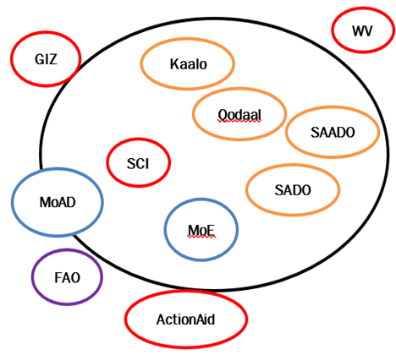
Hayadaha/Ururada Tuulada Ka Shaqeeya
Ururka amma Hayada lad | Shaqooyinka Muhimka ah
ActionAid | Kobcinta xirfadah ururada bulshada ee xaga maamulka lacagta, dhoobqaad balayga biyaha, iyo qaybinta qarbadada biyaha
World Vision | Taageero maliyadeed oo dumarka la siiyay
Hayada Badbadada Caruurta (SCI) | Adeegyada caafimaadka, nafaqaynta iyo xuquuqda caruurta
Haayada Beeraha Aduunka | Tageerao lacag siin, abuurka beeraha iyo taageerada beeraha
GIZ | Moosaska ka hortaga carro guurka, dib-uhabynta 2 barkadood iyo dhismaha 3 barkadood oo cusub
Qodal | Dib-uhabaynta dugsiga, dhismaha socda ee xarunta caafimaadka,wacyigalinta iyo iskaashiga bulsahada
Wasaarada Beeraha | Taageero abuur iyo horumarinta beeraha
Wasaarada waxbarashada | Mushaharaadka macalimiinta iyo agabka waxabarashada
SADO | Taageerada dumarka iskood isu abaabula, geeriyaha iyo aroosyada
SAADO | Taageerada dumarka iskood isu abaabula ee adeegyada arimaha bulshada
Kaalo | Taageerada kooxaha ka ganacsada iibinta caanaha

Slide 4
Howlaha Waxqabad ee Laga Maalgalinayo Mashruuca Barwaaqo
Howlaha waxqabad | Faahfahinta Waxqabadyada (quantities, hectares…)
Dhismaha Dhaam Biyood Cusub | Dhismaha Dhaam biyood cusub oo leh cabirka 40m balaca, 40m dhererka iyo 4.5 m oo joog ah. Samaynta kayd kor loodhisay, 1 qasabad biyaha laga cabo, 1 darka xoolaha, qolalka waardiyaha iyo 2 suuli. In la sameeyo nidaam qasabao biyaha qaybiya, nidaamka tamarta cadceeda oo biyaha kasoo saaraya Tobabaro lasiiyo gudiga maamulka biyaha
Adeega caafimaadka xoolaha | Tobabarada daryeelayaasha caafimaadka xoolaha, siinta 2 mooto iyo dawooyinka iyo adeega caafimaadka xooloaha
Dib uxoolaynta qoysaska nugul | 200 oo adhi iyo dameero ah oo loo qaybiyo 10 qoys oo nugul
Dhismaha Xarunta ururinta caanaha iyo hagaajinta silsiladda suuqgayta caanaha | Doorashada goobta, dhismaha xarunta ururinta caanaha oo leh nidaamka tamarta cadceeda, qaboojiye iyo agabka kala duwan ee canaha loo istcimaalo Abuurista kooxo rasmiya oo canaha ka ganacsada
Kor uqaadista calafka xoolaha | Soo iibinta qalabka gacmeedyada loo itcimaalo soosaarista calafka xoolaha, dhismayaal lagu kaydiyo calafka xoolaha, in lasoo iibiyo lana rikibo mashinada lagu farsameeyo calafka xoolaha In ladhiso lana tobabaro iskaashatooyin soosaara calafka xoolaha Tobabaro ku saabsan soosaarista, farsamaynta iyo maaraynta calafka xoolaha
Kor uqaadista dhaqashada digaaga | Soo iibinta nooc digaaga ah oo adkaysi uleh isbadalka cimilada Dhisida guryo digaag oo casri ah, sanduuqyada ay ku dhalaan, agabka lagu quudiyo, iyo kuwa biyaha ka cabaan, Tobabra itus oo itaabsi ah oo ku saabsan dhaqashada digaaga
Kor uqaadista dhaqashada shinida | In la siiyo sanaaduuqda shinida, dirayska, galoofiska, iyo agabka kale ee shinida, qiijiyayaasha, agabkan oo loo qaybin doono 20 qoys oo 10 kamida ay dumarku hogaaminayaan Tobabaro la xidhiidha maaraynta shini dhaqashada, maaraynta sanduuqyada, iyo gurashada malabka iyo ku xidhista suuqyada malabka
Taagerada agabka waxsoosaarka beeraha | Taageerada abuurka iyo qalab gacmeedka beeraha oo tayadoodu sarayso Tobabaro hanaanka wanagsan ee waxberashada oo la sii 50 qoys
Dhisida iskaashatooyin beeralay iyo meelo ay wax ku kaydsadaan | In la dhiso 2 iskaashato beeralay In la dhiso bakhaar leh nidaamaka tamarta cadceeda iyo qaboojiye
Fulinta nidaamyada ilaaliya carrada iyo biyaha | In la dhiso 14,400 m( udhigma 50 hiktar) oo mosaska carrada iyo biyaha ilaaliya, 98m3 oo biyaxidhenada dahgaxa ah( udhigma 20 hiktar) iyo 81 m3 moosaska dhagaxa laga sameeyo ee ilaliya carrada iyo biyaha(oo udhigma 15 hiktar)
Tobabar maamulka Khyraadka dabiiciga ah | Tobabaro ituso itaabsi ah oo lagu bixiyo goobaha tobabarada Diyaarinta hagayaasha tobabarada

Slide 5
Howlaha kale ee hortabinta u leh tuulada: maalgelinta looga raadinaayo mashruucada kale
Caqabadaha Gaarka Ah | Waxa Loo Bahanyahay in Laga Qabto
Jiritaan la,aanta dugsi sare | In la dhiso, lagana sahqaysiyo dugsi sare
Jiritaan la,aanta xirfadaha iyo fursadaha tobabarada | In dhalinyarta loo abuuro fursado ay uga qayb gali karaan tobabarada casharada xirfadaha farsmada gacanta
Jiritaan la,aanta adeeg caafimaad oo udhow | Qalabaynta xarunta dhalaanka iyo hooyada, tageerada dawwoynka iyo shaqaalaha xarunta

Slide 6
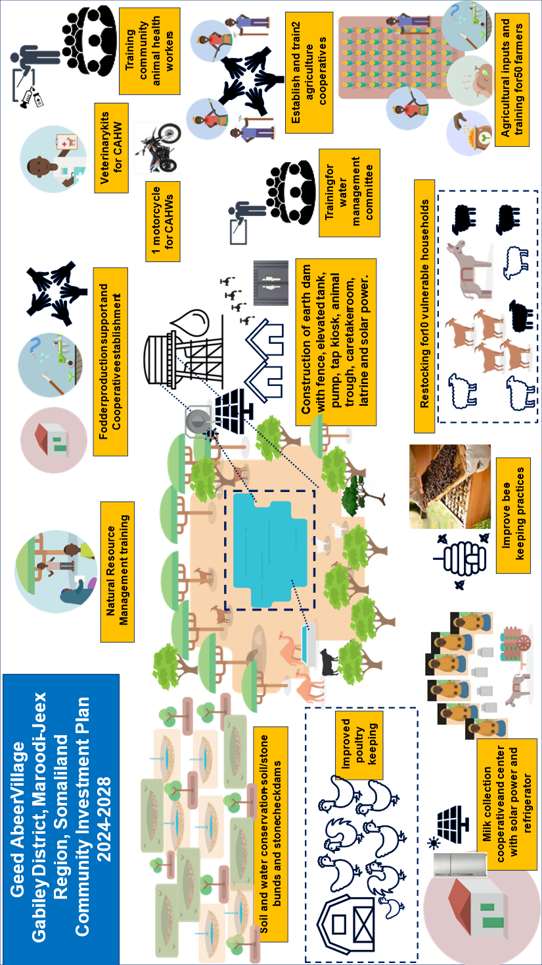
Jaantuska Qorshaha Maalgelinta Tuulada oo Kooban

