Slide 1

Mashrruca Barwaaqo: Baanka Adduunka – Dowladda Somaliland
Qorshaha Horumainta Bulshada 2024—2028
Tuulada Garabis, Degmada Farawayne ee Gobalka Maroodijex
Nidaamka Biyaha: Dhisida Dhaam Biyood Cusub .
Barta Uu Kuyaalo: 20km Koonfur galbeed Hargaysa. GPS: N: 9.4309 E: 43.9557
Tirada Bulshada: 500 households oo degan ah iyo ilaa 300 oo reguraa biyaha soo doonta xiliyada abaarta.
Tuulooyinka Hoos Yimaada: 0.
Ilaha Dhaqaalaha Muhimka Ah: Xoolo Dhaqato beeralay ( Geel, Lo,o iyo Adhi ), iyo beeraha yaryar ee roobka , xoogsatada malinlaha
Leadership: Village Development Committee of 7 (5 men, 2 women), Elders committee.
Aragtida Bulshada
Bulshada Guud: Degaan helitannka biyaha dadka iyo xoolahaba joogto yihiin sanadka oo dhan, sidoo kalana leh adeegyo cafimaad iyo waxbarasho oo dhamaystiran. Badqabka degaanka iyo waxsoosaarka xoolaha iyo berahana kor looqaday si leh waritaan mudo dheer. Haweenka : daryeelka cafimaadka oo kor loo qaaday, waxbarasho iyo helitaanka biyo joogto ah sandkoo dhan una dhow guryahooda. Sidoo kale fayadhowrka degaanka oo la hagaajiyay iyadoo la dhisay suuliyaal Dhaliyarada Dumar ah: In ay helaan waxbarasho adeeg cafimaad oo la hurumariyay, xirfadaha farsmada gacanta, tobaro, iyo shaqooyin si ay sifican ugu noladaan tuuladooda Dhaliyarada Raga ah: Dhalinyarada oo awoodooda waxbarasho iyo xirfadaba kor looqaday, helayn tobabaro khuseeya beeraha iyo xoolahaba, sidoo kalena in helaan meelo loogu talagaly ciyaaraha iyo jimicsiga.
Arimaha Hortabinta U leh Bulshada
Maamulka Illaha Biyaha | Dhisida dhaam biyood cusub, taangiga kayd, nidaamka tamarta cadceeda, qasabada iyo dararka xoolaha Kor qaadida arimaha fayadhowrka iyo nadafada bulshada
Xoolaha iyo Beeraha | Xoolaha Dhisida xarunta adeega caafimaadka Kor uqaadista adeegyada caafimaadka xoolaha Koruqdista waxsoosaarka calafka xoolaha Dib u xoolaynt dadka ay samaysay isbadalka cimaladu Suuq gaynta ukunt/beedka iyo malabka Beeraha Helitaanka abuur, caro nafaqeeye iyo agabka gacmeedka beeraha oo tayo sare leh Koruqaadista aqoonta beeraha ee beeralayda Helitaanka taagerada waxberashada sida; abuur, cara nafaqeyaha iyo sunta cayayaanka Maraynta cayayaanka beeraha cunna Horumarinta waraabka beeraha iyo qaybinta qarbadada lagu kaydsado biyaha
Degaanka | Dib usoo noolaynta dhul daaqsimeedka Dhisida Moosaska carada iyo dhagaxa ee ka horatago caroguurka/nabaad guur Beerista geedo cusub iyo ilaalnta kaymaha Kor uqaadista xirfada iyo aqoonta ilaalinta carrada iyo biya ee bulshada degaanka In shaqo loo abuuro bulshada qaybta ku tiirsan isticmaalka dhirta– dhuxulaysatada

Slide 2
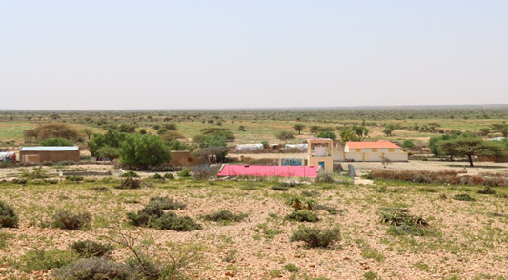
Taariikhda of CIP lafuliyay: 23-26 July 2024
Tirada Dadka Lala Tashaday
7 xubnood oo gudiga tuulada ah (5 raga, 2 dumara)
29 Haweena
33 Dhalinyara (18 rag, 15 dumar)
7 Beeralay (5 raga, 2 dumara)
8 Xoola dhaqato ah (6 raga 2 dumara)
7 gudiga biyaha ah (7 raga, 0 dumara)
83 bulshada guud ah (68 rag, 15 dumar)
Kooxda CIP Ka Fududaysay (29 % ayaa dumar ah):
Qaybta hirgalinta Mashruca Barwaaqo : khabiirka badqabka bulshada, khabiirka Badqabka Degaanka Khabiirka Xagudubyada Jinsiga , Khabirka xidhiidhinta mashruca , Lataliyaha Diyarinta qorshaha horumarinta bulshada iyo sargaalka qorshaha horumarinta bulshada
Khabiirada Ka Socda Wasarada Mashruuca Fuliya: Khabiirada xoolaha, beeraha, degaanka iyo biyaha.
Tuulada Garabis : Gudomiyaha, Gudiga horumarinta Tuulada , iyo Qaybaha kala duwan ee Bulshada ,
Jadwalka Xilli-Taariiikheedka
Goobta: Garabis | Abr. | Maaj | Juun. | Luul. | Ogo. | Sebt. | Okt. | Nof. | Dis. | Jan. | Febr. | Maarj.
Sanadka Xiliyadiisa | Gu’ |  |  | Xagaa |  |  | Deyr |  |  | Jiilaal
Roobka | X | XX | X | XX |  |  | X X | X | X
Xilliga xooluhu calool galaan |  |  |  |  |  |  |  |  | X | X | X | X
Xilligu ay xooluhu dhalaan | X | XX |  |  |  |  |  | X
Wakhtiyada calafka La Heli Karo |  | XX | X | X | X |  | XX |  |  | X
Wakhtiyada Canaha iyo Subaga la heli karo |  | XX | X | X |  | X | XX | XX
Xiliyada Ugu fican Iibka Xolaha | XX | XX | XX | X | X | X | X | X | X | X | X | X
Wakhtiyada xooluhu ka hayaaman degaanka |  |  | X |  |  |  |  |  | X | X
Wakhtiyada Cudurada xoolaha badan yihiin |  |  | X | X | X |  |  |  | X | X
Xilliyada Gaajada |  |  |  |  |  |  |  |  |  | X | X
Wakhtiyada Cudurada dadka ku dhaca ay badan yihiin |  |  | X | X |  |  |  |  | X | X | X
Wakhtiyada la beero dalagyada muhiimka ah | XX | XX | X |  |  |  | X | X | X
Xiliga goosashada beeraha |  |  |  | X | X |  |  |  |  | X
Xilliyada guurka Badan yahay | X | X | X |  |  |  |  | X
Xilyada Wax aad Loo Amaahdo |  |  |  |  |  |  |  |  |  | X | X | X
Wakhtiyada Iskoolka La dhigto | X | X | X |  |  | X | X | X | x |  | X | X

Slide 3
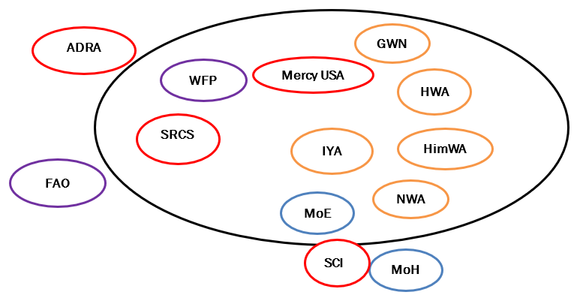
Hayadaha/Ururada Tuulada Ka Shaqeeya
Ururka amma Hayada lad | Shaqooyinka Muhimka ah
Hayada Cuntada Aduunka | Taageero raashinka iyo lacagta
Hayada Beeraha Aduunka | Tageero lacag, abuurka beraha iyo xidhxidhka beeraha
ADRA | Dhisme Balay biyo
Mercy USA | Dayactic laba barkadood, kayd biyo, mishiino iyo qasabado
SRCS | Saacado qodaal beraha
Wasaarada Waxbarashada | Dhismaha, qalabaynta iyo mushaharka macalimiinta
Wasaarada Caafimaadka | Dhismaha Xarunta Caafimaadka
Dalada Ururka Garabis | Taagerada qoysaska danyarta ah iyo samaynta ururada dhexdooda iskaashada/iscaawiya
Ururka Dhalinyarada Ee Intifaac | Ololaha nadafada degaanka

Slide 4
Howlaha Waxqabad ee Laga Maalgalinayo Mashruuca Barwaaqo
Howlaha waxqabad | Faahfahinta Waxqabadyada (quantities, hectares…)
Dhismaha Dhaam Biyood Cusub | Dhismaha Dhaam biyood cusub oo leh cabirka 75m balaca, 100m dhererka iyo 3.10m oo joog ah, kasoo la dhigayo qarbidka biyaha haya. Samaynta qasabadaha biyaha laga cabo, dararka xoolaha, qolka waardiyaha iyo xayndaab siliga
Dhismaha xarun caafimadka xoolaha | Dhismaha xarunta caafimaka xoolaha oo ka kooban 2 qol, barande, 2 suuli iyo dayr kusoo waregsan. Xaruntu waxay ku fadhidaa 20 m oo labajibaran
Tobabar iyo Tageero qalab lasiyo daryeelayaasha caafimaadka xoolaha | Tobabro la siiyo daryeelayaasha caafimaadka xoolaha Dawooyin iyo qalab caafimaad oo lasiiyo daryeelayaasha caafimaadka xoolaha
Dib uxoolaynta qoysaska ay xooluhu ka baxeen | In lasoo iibiyo 450 adhi ah oo loo qaybiyo 30 qoys oo qoyskiba u helaayo 15 neef
In 15 qoys oo ah kuwa nugul laga tageero dhaqashada shinida | Soo ibinta sanduuyada shinnida(Gaagur), dirayska, gacmo gashadka(Gloves), qiijiyaha iyo qalabyada kale ee shinnida loogu bahan yahay. Bixinta tobabar la xidhiidha mamaulka, dyactirka sanaduuqda shinida iyo gosashada malabka.
In kor loo qaado dahaqashada digaage ee qoysaska nugul | In loo soo iibiyo nooc digaaga oo adkaysi uleh cimilada In loo dhiso guryo digaag oo casriya, lehna melaha ay ku dhalayan, nidaam quudis iyo meelihii biyaha laga cabayay.
Taageerada agabka beeraha | In 60 beeralay loo soo iibiyo loona qaybiyo agabka beeraha sida; abuurka, qalab gacmeedka, mishiinada iyo qarbadada biyaha lagu kaydsado oo
Dhisida kooxo dugsi beeralay, xirfadoodana kor loo qaado | In la dhiso xirfadoodana kor looqada 2 dugsi beeralay oo midkiba ka kooban yahay 30 xubnood. Tobabaro la sinaayo waxa ka mida wax soo saarka beraha iyo maraaynta cayayaanka iyo xanuunada
Dhisida uru ka shaqeeya dhul daaqsimeedka | In la sameeyo talaabooyin kala duwan oo lagaga horatagayo carro guurka( Dib ayaa laga sheegi donaa)
Taageerada qalab loo isticmalaayo dib-uhabaynta dhul daaqsimeedka | Taagero qalabka loo istcimalayo dib-uhabaynta dhul daaqsimeedka sida; majarafado, yaambooyin, labagadhlay, machooyin, iyo madaraq
Tobabaro ku saabsan xakamaynta nabaad guurka | Tobabaro la xidhiidha dib-udhiraynta iyo dhisida moosaska ka hortaga carro guurka.
Ilaalinta dhirta | In la beero 300 oo geeda asalka u ah degaanka, lana sameeyo guddi ilaalisa kaymaha
Dhisida ururka maamulka dhul daaqsimeedka | In la dhiso urur ka shaqeeya maamulka dhul daaqsimeedka

Slide 5
Howlaha kale ee hortabinta u leh tuulada: maalgelinta looga raadinaayo mashruucada kale
Caqabadaha Gaarka Ah | Waxa Loo Bahanyahay in Laga Qabto
Jiritaan la,aanta dugsi sare | In la dhiso, lagana sahqaysiyo dugsi sare
Jiritaan la,aanta tobabarada xirfadaha farsamada gacanta | U abuurista iyo ka qaybgalinta dhalinyarta xarumo tobabarada xirfadaha farmsada gacanta
Adeegyada caafimaadka bulshada | In la qalabeeyo, xarunta caafimaadka, dawooyinka iyo shaqalahana la keeno
Suliyo la,aan | In loo dhiso suuliyo qoysaska aadka danyarta u ah

Slide 6
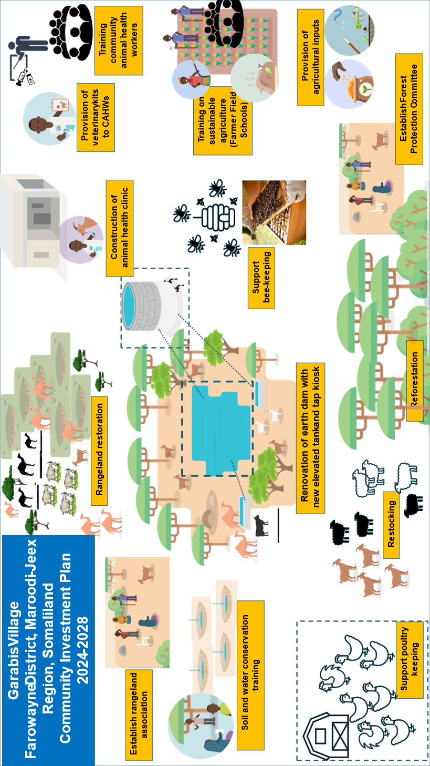
Jaantuska Qorshaha Maalgelinta Tuulada oo Kooban

