Slide 1

Mashrruca Barwaaqo: Baanka Adduunka – Dowladda Somaliland
Qorshaha Horumainta Bulshada 2024—2028
Tuulada Ceelbaxay, Degmada Laas ciidle ee Gobalka Saaxil
Nidaamka Biyaha: Dib uhabaynta Ceel biyood, taangi kayd, dararka iyo qasabadaha biyaha.
Barta Uu Kuyaalo: 125km Bariga Berbera. GPS: N: 8.80255 E: 044.63168
Tirada Bulshada: 547 households oo degan ah iyo ilaa 2000 oo reguraa biyaha soo doonta xiliyada abaarta.
Tuulooyinka Hoos Yimaada: 11.
Ilaha Dhaqaalaha Muhimka Ah: Xoolo Dhaqashada ( Geel, Lo,o iyo Adhi ), ganacsiyada yaryar(Canaha, subaga iyo khudaarta), iyo beeraha yaryar ee khudaarta (tomaato, Qajida, barbarooni, basal, xabxab).
Leadership: Village Development Committee of 7 (4 men, 3 women), Elders committee.
Aragtida Bulshada
Bulshada Guud: Degaan barwaaqo ah, islamarkaana biyaha macaan loo helaayo sanadka oo dhan dadka iyo xoolahaba, sidoo kalana leh adeegyo cafimaad iyo waxbarasho oo dhamaystiran, fursadaha ilo dhaqaale oo kala duwan la abuuray iyadoo taageero dhamaystiran la siinaayo dadka nugul. Sidoo kala la xaliyay dhamaan caqabadaha degaanka iyo xoolaha. Haweenka : , daryeelka cafimaadka oo kor loo qaaday lehna dumar adeegayaal caafimaad oo xirfad sare leh, adeega qasabada biyaha oo udhow guryaha, nadafada iyo fayadhowrka bulshada oo la haagiyay iyo korodhka tageerada dhaqaale ee lasiiyo dumarka Dhaliyarada (Rag and Dumarba): In ay helaan waxbarasho dugsi sare, xirfadaha farsmada gacanta, meelo ay ku ciyaraan, adeeg caafimaad oo fican iyo koradh tageero dhaqaale. Dadka Naafada ah: In ay heli karaan, meelo ay marikaraan, ilo dhaqaale oo ay umadax banan yihiin, sida lahaanshaha xoolo, beero. Iyo in ay helaan adeegyo caafimaad iyo waxbarasho oo ku haboon xaladooda naafanimo.
Arimaha Hortabinta U leh Bulshada
Maamulka Illaha Biyaha | Dhisida ceel gacmeed leh kayd biyo oo la taagay, nidaamka tamarta cadceeda, qasabada iyo dararka xoolaha Samaynta qasabadaha biyaha ee tuulada Dhisid guddiga maamulka nidaamka biyaha oo xoogan oo shaqaynaayo Kor qaadida arimaha fayadhowrka iyo nadafada bulshada
Xoolaha iyo Beeraha | Xoolaha Dhisida xarunta adeega caafimaadka Tobabarka iyo qalabaynta daryelayaasha adeegyada caafimaadka xoolaha Koruqdista waxsoosaarka calafka xoolaha In la bilaabo dhaqashada shinnida Beeraha Tobabaro ku saabsan nidaamka beeraha waxsoosaarkoodu waaro Helitaanka abuur, caro nafaqeeye iyo agabka gacmeedka beeraha oo tayo sare leh Helitaanka nidaamka waraabka biyaha tashiila oo loo isticmaalayo habka tamarta cadceeda Dhisida iskaashatooyin beeralay ah
Degaanka | Fulinta howlo lagu ilaalinta nabaad guurka carada Kordhinta ilaalinta dhirta degaanka In loo abuuro fursado shaqo dadka ku tiirsan isticmaalka dhirta, sida dhuxlaystada Beerista geedo cusub and maamulka kaymaha

Slide 2
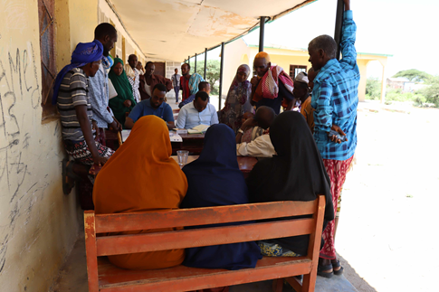
Taariikhda Date of CIP lafuliyay: 6-9 May 2024
Tirada Dadka Lala Tashaday
7 xubnood oo gudiga tuulada ah (5 raga, 2 dumara)
27 Haweena
21 Dhalinyara (13 rag, 8 dumar)
30 kamida dadka naafada ah( 13 rag, 17 dumara)
9 Beeralay (7 raga, 2 dumara)
10 Xoola dhaqato ah (7 raga 3 dumara)
7 gudiga biyaha ah (7 raga, 0 dumara)
123 bulshada guud ah (76 rag, 47 dumar)
Kooxda CIP Ka Fududaysay (36% ayaa dumar ah):
Qaybta hirgalinta Mashruca Barwaaqo : khabiirka badqabka bulshada, Khabiirka Xagudubyada Jinsiga , Khabirka xidhiidhinta mashruca , Lataliyaha Diyarinta qorshaha horumarinta bulshada.
Khabiirada Ka Socda Wasarada Mashruuca Fuliya: Khabiirada xoolaha, beeraha, degaanka iyo biyaha.
Tuulada Ceelbaxay : Gudomiyaha, Gudiga horumarinta Tuulada , iyo Qaybaha kala duwan ee Bulshada ,
Jadwalka Xilli-Taariiikheedka
Goobta: Ceelbaxay | Abr. | Maaj | Juun. | Luul. | Ogo. | Sebt. | Okt. | Nof. | Dis. | Jan. | Febr. | Maarj.
Sanadka Xiliyadiisa | Gu’ |  |  | Xagaa |  |  | Deyr |  |  | Jiilaal
Roobka | X | XX | X |  |  |  | X | XX
Xilliga xooluhu calool galaan |  | XX |  |  |  |  |  | X | X
Xilligu ay xooluhu dhalaan |  | X |  |  |  |  |  | X
Wakhtiyada calafka La Heli Karo |  | X | XX | X |  | X | X X | X
Wakhtiyada Canaha iyo Subaga la heli karo |  | X | XX | X |  | X | XX | X
Xiliyada Ugu fican Iibka Xolaha |  |  | X X | X | X |  |  |  |  | X | X | X
Wakhtiyada xooluhu ka hayaaman degaanka |  |  |  | X | X | X |  |  |  | X | X | X
Wakhtiyada Cudurada xoolaha badan yihiin | XX | XX | X |  |  |  |  |  | X | X | X
Xilliga gaajada |  |  |  |  |  |  |  |  | X | X | X | X
Wakhtiyada Cudurada dadka ku dhaca ay badan yihiin | X | XX | X |  |  |  |  |  | X | X | X
Wakhtiyada la beero dalagyada muhiimka ah |  |  |  |  | X X | X | X |  |  |  | X
Xiliga goosashada beeraha | X | X |  |  |  |  |  |  |  | X
Xilliyada guurka Badan yahay | XX | XX | XX |  |  | X | XX | X

Slide 3
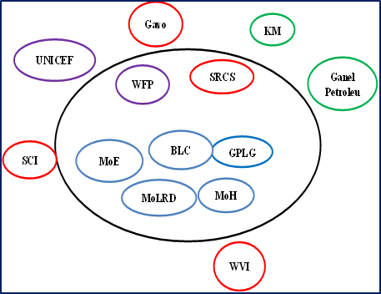
Hayadaha/Ururada Tuulada Ka Shaqeeya
Ururka amma Hayada lad | Shaqooyinka Muhimka ah
Hayada Cuntada Aduunka/Gavo | Taageero raashin
Hayada Beeraha Aduunka | Dhisme wado iyo isticmalasa nidaam raashin dadku ku saqaynayaan
World Vision | Tageero Lacageed
Hayada Bisha Cas | Fayadhowrka, suliyaal, qalabka gacanta iyo wacyigalin
Wasarada Waxbarasahada/UNICEF and SCI | Mushaharka Macalimiinta, dhismaha iskoolka, iyo agabka waxbarshada
Wasaarada Cafimadka | Dhismaha, qalabaynta iyo dawada xarunta cafimadka dhalanka iyo hooyada
Wasaarada Xanaanada Xoolaha | Talaalka Xoolaha
Mashruuca Barwaaqo | Biyaha iyo qimaynta degaanka
Dowlada hoose ee Berbera | Dawooyinka ,iyo bixinta mushaharadka maclaimiinta iyo shaqalaha caafimadka
General Energy Company | Ka qayb qadashada dhismaha xarunta caafimaadka
PRM Mining Company | Xarunta booliska,Iftiminta suqa iyo shaqalaysin ilaa 70 qof ah

Slide 4
Howlaha Waxqabad ee Laga Maalgalinayo Mashruuca Barwaaqo
Howlaha waxqabad | Faahfahinta Waxqabadyada (quantities, hectares…)
Dib uhabaynta ceel-biyoodka | Dhoobo qaad, silig lagu wareejiyo, dhisida taangi kor lootagay, qasabado iyo dararka xoolaha
Adeegyada caafimaadka xoolaha | Dawooyinka iyo qalabka xoolaha lagu daweeyo, tobarada daryeelayasha adeega caafimadka xoolaha Daawaynta iyo talaalka xoolaha
Tobabaro ku saabsan maamulka cayayaanada iyo xanuunada | Tobarada xanuunada sida joogta ah uga dhaca degaankan
Dhisidda gudi-hosaadka horimanta | Kulamo gudiga horumarinta bulshado oo la ogaysiiyo shurrudaha xubnaha gudi-hosaadka lagu doranaayo iyo bixinta tobabar hordhac, samaynta qaabdhismeed gudi-hosaadka iyo xeer hosaadkodaba
Dib usoo noolaynta dhul daaqsimeedka | Dhisida 3,840 M oo dherer ah oo moosas carada iyo biyaha qabta oo gadhaya ilaa dhul ah 14 hictar, Dhisida 108m3 biyo xidheenada dhagaxa oo gadhay 3.5 hiktar oo dhula, iyo 200m3 of Moosaska dhagaxa(7 hiktar si loo xakameeyo socodka biyaha roobka, loogana hortago nabaad-guurka dhulka
Tababar Xakamaynta Nabaad-guurka iyo Maareynta Biyaha | Tababaraha, diyaarinta qalabka iyo bugaagta tobabarka
Dib udhirayn degaanka | Beerista 4,000 dhirta asalka u ah degaanka iyo dalakaba
Dhirayn | Beerista 4000 oo geed oo dhirt xerodhaladka ah
Bixinta Girgirayaasha tamarta madhxiya | In loo qaybiyo girgirayasha madhxiya tamarta qoysaska danyarta ah ee nugul
Dhisida uru ka shaqeeya dhul daaqsimeedka | In tuulooyinka laga dhiso ururo ka shaqeeya lanasocda maamulka iyo ilaalinta dhul daaqsimeedka

Slide 5
Howlaha kale ee hortabinta u leh tuulada: maalgelinta looga raadinaayo mashruucada kale
Caqabadaha Gaarka Ah | Waxa Loo Bahanyahay in Laga Qabto
Jiritaan la,aanta dugsi sare | In la dhiso, la qalabeeyo oo macalimiina loo keno dugsiga sare ee tuulada
Jiritaan la,aanta tobabarada xirfadaha farsamada gacanta | U abuurista iyo ka qaybgalinta dhalinyarta xarumo tobabarada xirfadaha farmsada gacanta
Adeegyada caafimaadka bulshada | In la keeno shaqale caafimaad oo dumar ah
Jiritaan la,aanta xarunta kulanka haweenka | In la dhiso lana qalabeeyo xarunta horumarinta haweenka, sidoo kalana loo shaqalaysiyo tobabare xirfad leh
Jiritaan la,aanta adeegyada dadka qaba baahiyaha gaarka ah ee xarunta caafimaadka | In laga dhigo xarumaha caafimaadka kuwa koobsanaya dhamaan adeegyada bulshadu ubaahantahay oo ay ku jiraan kuwa u adeegaya dadka baahiyaha gaarka ah qaba, sidoo kalana lasiiyo taagero maaliyadeed dadka baahiyaha gaarka ah qaba.
Dib uxoolaynta dadka xooluhu ka baxeen | Uqaybinta xoolo dadka xooluhu abaaraha kaga baxeen( adhi iyo lo,o)

Slide 6
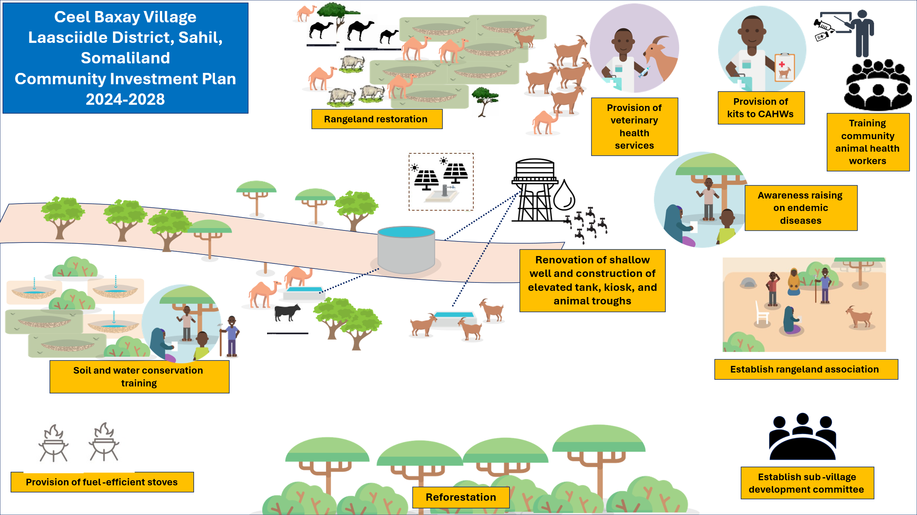
Jaantuska Qorshaha Maalgelinta Tuulada oo Kooban

