Slide 1

Mashrruca Barwaaqo: Baanka Adduunka – Dowladda Somaliland
Qorshaha Horumainta Bulshada 2024—2028
Tuulada Boodhlay, Degmada Gabilay ee Gobalka Maroodijex
Nidaamka Biyaha: Dhisida Dhaam Biyood Cusub .
Barta Uu Kuyaalo: 60 km galbeedka Hargaysa. GPS: N: 9.5348 E: 43.5131
Tirada Bulshada: 2000 households oo degan ah iyo ilaa 250--300 oo reguraa biyaha soo doonta xiliyada abaarta.
Tuulooyinka Hoos Yimaada: 9.
Ilaha Dhaqaalaha Muhimka Ah: Xoolo Dhaqato beeralay ( Geel, Lo,o, Adhi iyo digaag ), iyo beeraha yaryar ee roobka (garow, digirta, tomato, qaji, xabxab iyo sisinta), xoogstada malinlaha
Leadership: Village Development Committee of 9 (9 men, 0 women), Elders committee.
Aragtida Bulshada
Bulshada Guud: In sanad oo dahan ay ka helaan dhaamka loo dhisayo biyo joogta ah, ayna kawaraabsan karaan beeraha, Sidoo kale helitaanka adeegyada cafimaad xoolaha iyo dadka oo kor looqaday iyo inay noqoto tuuladu xudunta waxsoosaarka beerha; gaar ahaan salidaha iyo calafka xoolaha. Haweenka : In ay sanadkoo dhan helaan biyo joogto, daryeelka cafimaadka iyo waxbarashada oo kor loo qaaday. Sidoo kale in la xoojiyo ka ganacsiga axsoosaarka xoolaha iyo beerha si ay waxsoosarkoda ugu biriyaan suuqaqa wadanka. Dhaliyarada Dumar ah: In ay arkaan bulsahada oo koraysa oo haysta biyo nadifa, waxbarasho tayadeedu sarayso, adeeg caafimaad oo dhamaystiran, kaabayasha nolosaha oo casriyaysan iyo degaanka oo xoroobay geedka garanwaaga. Dhaliyarada Raga ah: In ay arkaan dhalinyarada Boodhlay oo si firfircoon uga qayb qaadanasa horuminta bulshada, iyo helaya dugsi sare oo udhow, caafimaadka hooyada iyo dhalaank, caafimaadka xoolaha oo la horumariyay, waraabka beeraha, sidoo kalena in helaan meelo loogu talagaly ciyaaraha iyo jimicsiga.
Arimaha Hortabinta U leh Bulshada
Maamulka Illaha Biyaha | Dhisida dhaam biyood cusub, taangiga kayd, nidaamka tamarta cadceeda, qasabada iyo dararka xoolaha Kor qaadida arimaha fayadhowrka iyo nadafada bulshada
Xoolaha iyo Beeraha | Xoolaha Dhisida xarunta adeega caafimaadka xoolaha Koruqdista waxsoosaarka calafka xoolaha iyo farsamayntisa Tayayta iyo kor uqaadista noocyada xoolaha( In la helo nooc xoolo ah cad iyo caanaba badan) Kor uqaadista iyo xoojinta ka ganacsiga xoolaha Beeraha Helitaanka taagerada waxberashada sida; abuur, cara nafaqeyaha iyo sunta cayayaanka Maraynta cayayaanka beeraha cunna Koruqaadista aqoonta beeraha ee beeralayda Horumarinta waraabka beeraha Waxsoosaarka beeraha oo la suuq geeyay
Degaanka | Tobabaro maamulka khayraadka dabiiciga Dhisida Moosaska carada iyo dhagaxa ee ka horatago caroguurka/nabaad guur Xakamaynta iyo maamulka dhirta noocyada faafa Kor uqaadista maamulka degaanka

Slide 2
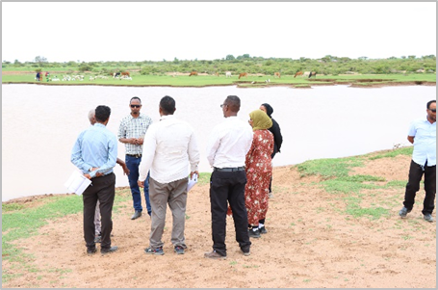
Taariikhda of CIP lafuliyay: 28-31 May 2024
Tirada Dadka Lala Tashaday
9 xubnood oo gudiga tuulada ah (9 raga, 0 dumara)
43 Haweena
28 Dhalinyara (12 rag, 16 dumar)
8 Beeralay (6 raga, 2 dumara)
9 Xoola dhaqato ah (7 raga 2 dumara)
12 gudiga biyaha ah (7 raga, 5 dumara)
320 bulshada guud ah (215 rag, 15 dumar)
Kooxda CIP Ka Fududaysay (29 % ayaa dumar ah):
Qaybta hirgalinta Mashruca Barwaaqo : khabiirka badqabka bulshada, Khabiirka Xagudubyada Jinsiga , Khabirka xidhiidhinta mashruca , Lataliyaha Diyarinta qorshaha horumarinta bulshada iyo sargaalka qorshaha horumarinta bulshada
Khabiirada Ka Socda Wasarada Mashruuca Fuliya: Khabiirada xoolaha, beeraha, degaanka iyo biyaha.
Tuulada Garabis : Gudomiyaha, Gudiga horumarinta Tuulada , iyo Qaybaha kala duwan ee Bulshada ,
Jadwalka Xilli-Taariiikheedka
Goobta: Boodhlay | Abr. | Maaj | Juun. | Luul. | Ogo. | Sebt. | Okt. | Nof. | Dis. | Jan. | Febr. | Maarj.
Sanadka Xiliyadiisa | Gu’ |  |  | Xagaa |  |  | Deyr |  |  | Jiilaal
Roobka | X | XX | X | XX |  |  | X X | X | X
Xilliga xooluhu calool galaan |  |  |  |  |  |  |  |  | X | X | X | X
Xilligu ay xooluhu dhalaan | X | XX
Wakhtiyada calafka La Heli Karo | XX | XX | X | X | X |  | XX | X | X | X
Wakhtiyada Canaha iyo Subaga la heli karo |  | XX | X | X |  | X | XX | XX
Xiliyada Ugu fican Iibka Xolaha | XX | XX | XX | X | X | X | X | X | X | X | X | X
Wakhtiyada xooluhu ka hayaaman degaanka |  |  | X |  |  |  |  |  | X | X
Wakhtiyada Cudurada xoolaha badan yihiin |  |  |  | X | X |  |  |  | X | X | X
Xilliyada Gaajada |  |  |  |  |  |  |  |  | X | X | X
Wakhtiyada Cudurada dadka ku dhaca ay badan yihiin |  |  | X | X |  |  |  |  | X | X | X
Wakhtiyada la beero dalagyada daruuriga ah | XX | XX | X |  |  |  | X | X | X
Xiliga goosashada beeraha |  |  |  | X | X |  |  |  |  | X
Xilliyada guurka Badan yahay | X | X | X |  |  |  |  | X
Xilyada Wax aad Loo Amaahdo |  |  |  |  |  |  |  |  |  | X | X | X
Wakhtiyada Iskoolka La dhigto | X | X | X |  |  | X | X | X | x |  | X | X

Slide 3
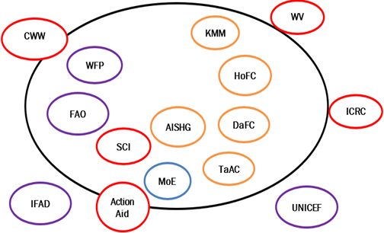
Hayadaha/Ururada Tuulada Ka Shaqeeya
Ururka amma Hayada lad | Shaqooyinka Muhimka ah
Hayada Cuntada Aduunka | Taageero maaliyadeed( 500 oo qoys oo min 20 dollar bishii)
ActionAid | Tageero abuurka beraha(Sunflower) iyo ganacsiga dumarka
Hayadda Beeraha Aduunka | Taageero calafka xoolaha
Concern Worldwide | Taagerada dhinacyo badan oo u adkaysiga bulshada
IFAD | Dhismaha xarunta dhalaanka iyo hooyada, dayacticka balayga biyaha iyo tageerada qodaalka beeraha
ICRC | Taageero cunto iyo alaabooyinka aan cuntada ahayn
Save the Children | Adeegyada caafimaadka iyo nafaqaynta
Wasaarada waxbarashada | Mushaharaadka iyo qalabaynta iskuulka
World Vision | Dayactirka Balay biyood
UNICEF | Taageerada caafimaka iyo waxbarashada
Ururka Alla-aamin | Amaah iyo Kaydka lacagaha
Iskaashatada Tawakal | Ka shaqaynta waxsoosaarka iyo suuqgaynta saliida gabaldayaha
Shirkada Suuq gaynta Caanaha ee Kaalo | Kashqaynta suuqgaynta

Slide 4
Howlaha Waxqabad ee Laga Maalgalinayo Mashruuca Barwaaqo
Howlaha waxqabad | Faahfahinta Waxqabadyada (quantities, hectares…)
Dhismaha Dhaam Biyood Cusub | Dhismaha Dhaam biyood cusub oo leh cabirka 40m balaca, 60m dhererka iyo 4.5 m oo joog ah, kasoo la dhigayo qarbidka biyaha haya. Samaynta kayd kor loodhisay, qasabadaha biyaha laga cabo, dararka xoolaha, qolka waardiyaha iyo xayndaab siliga iyada biyaha looga soo saarayo nidaamka tamarta cadceeda
Hagaajin adeegyada caafimaadka xoolaha | Dhismaha rugta caafimaka xoolaha Tobabarid, tageerada qalab iyo daawo ee daryeelayaasha caafimaadka xoolaha
Hagaajinta noocyada xoolaha( Genitic) | Xulista iyo Qiimeynta Noocyada Xoolaha ee La-qabsaday Cimilada isla markaana Wax-soosaar Sare Leh. Bixinta iyo Tijaabinta Shan Sac oo lo,da caanaha badan leh ah, lana siiyo qoysas lasoo xullo, si tobar dhaqashada casrga ah ee xoolaha loo siiyo
Xoojinta waxsoosaarka iyo ka ganacsiga xoolaha | In lasoo iibiyo 200 oo neef adhi ah oo loo qaybiyo ururada ay dumarku hogaaminayaan In la siiyo tobabaro la xidhiidha naaxinta xoolaha iyo adeegyada suuqqaynta Sidoo kalana in si joogta ah loola socdo isbadalka togan
Taageerada agabka waxsoosaarka beeraha | Soo iibinta iyo qaybinta qarbadada biya roobka lagu kaydsado, qalab gacmeedyo, mishiino iyo abuurka khudaarta oo tayadiisa la xaqiijiyay
Dhisida iskaashatootinka kooxaha dugsi beeralay | Siinta tobabaro nidaamyada waxberashada sida; beerashada salida gabaldayaha, hagaajinta midha ee gosashada kadib iyo nidaamyada xakamaynta xanuunada iyo cayayaanka
Hababka Ilaalinta Caradda iyo Biyaha | In la dhiso Moosaska ilaaliya carrada iyo biyaha ka ilaaliya nabaad guurka(xadiga waa la sheegi donaa) Tobab la xidhiidha qaabka samaytana moosaskan
Maaraynta Garanwaaga | Tobabaro ku saabsan maaraynta geedka garanwaaga iyo taagero qalabka loo isticmaalayo maaraynta garanwaaga

Slide 5
Howlaha kale ee hortabinta u leh tuulada: maalgelinta looga raadinaayo mashruucada kale
Caqabadaha Gaarka Ah | Waxa Loo Bahanyahay in Laga Qabto
Jiritaan la,aanta dugsi sare | In la dhiso, lagana sahqaysiyo dugsi sare
Dayacnaan iyo hadh la,aan caruurta dhigata dugsiga hoose | Dayr iyo hadh loo sameeyo dugsiga hoose
Fursadaha shaqo ee dhaliyarada | In la siiyo tobabaro xirfadaha lagu baraayo Sam In loo abuuro xarumaha bixiyaha totabarada xirfadaha gacanta
Jiritaan la,aanta adeeg caafimaad oo udhow | Qalabaynta xarunta dhalaanka iyo hooyada, tageerada dawwoynka iyo shaqaalaha xarunta
Nadaafad darrada degaanka | Dhismayaal suuliyaal iyo meelo xidhan oo qashinka la iskaga ururiyo
Taageero dheerada si loo xakameeyo loona mareeyo geedka garanwagaa | In la siiyo tobabaro ku saabsan qaababka loo xakamayn karo geedka garanwaaga iyo taageero qalab gacmeed iyo mashiino lagu xakameeyo geedka garanwaga

Slide 6
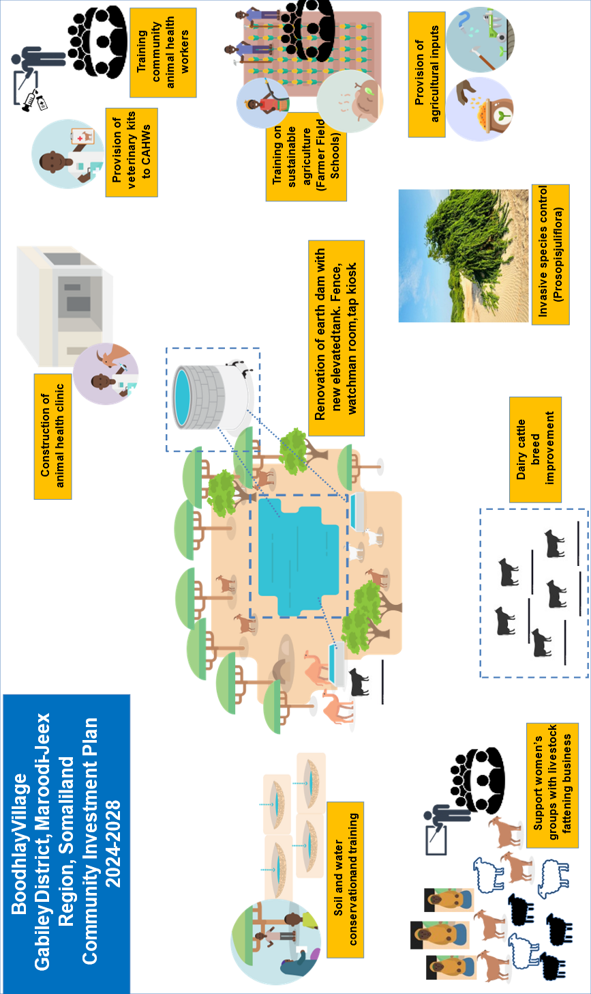
Jaantuska Qorshaha Maalgelinta Tuulada oo Kooban

