Slide 1

Mashrruca Barwaaqo: Baanka Adduunka – Dowladda Somaliland
Qorshaha Horumainta Bulshada 2024—2028
Tuulada Awbarkhadle, Degmada macalin Haruun ee Gobalka Maroodijex
Nidaamka Biyaha: Dib uhabaynta Biya xidhka doxa.
Barta Uu Kuyaalo: 30km Waqooyibarri Hargeisa, wadada Berbera. GPS: N: 09.68409 E: 044.30301
Tirada Bulshada: 440 households. Tuulooyinka Hoos Yimaada: 4.
Ilaha Dhaqaalaha Muhimka Ah: Xoolo Dhaqashada ( Geel, Lo,o Adhi, Digaag, iyo dameero), ganacsiyada yaryar, iyo beeraha yaryar ee khudaarta (Cambe babay, liin dhanan, Cambe laf, tomaato, Qajida, barbarooni, basal, cabbaj).
Leadership: Village Development Committee of 7 (5 men, 2 women), Elders committee.
Aragtida Bulshada
Bulshada Guud: Degaan cagaaran, barwaaqo ah oo lahayn wax gedaha xerodhaladka ahayn ee faafa, islamarkaana biyaha loo helaayo sanadka oo dhan beeraha iyo xoolahaba. Haweenka : Hiltaanka rasmaal iyo xirfado ganacsi , daryeelka cafimaadka iyo adegyada qoysaska oo kor looqaaday. Dhaliyarada (Rag and Dumarba): In ay helaan koruqaad waxbrasho, xirfadaha farsmada gacanta iyo taagero xaga horumarinta ganacsiga ah, si ay u koraan kana qayb qataan horumarka bulshada Barakayaasha: In ay helikaraan baahiyaha assasiga ah (guryo, biyo, cunto caafimad ) iyo fursadaha shaqooyinka. Dadka Naafada ah: In ay heli karaan taageero biliadantinimo iyo ka qaybqadasho firfircoon arimaha masiiriga ee bulshada dhexdeda.
Arimaha Hortabinta U leh Bulshada
Maamulka Illaha Biyaha | Dib udhiska biyoxidheenka doxada iyo ceel gacmeedka Samaynta qasabadaha biyaha ee tuulada Dibuhabaynta iyo dayactirka qolka kaydka, solarka iyo qasabadaha Tobabarka Maamulka Nidaamka Biyaha Tobabaro iyo wacyigalin kor loogu qaada arimaha fayadhowrka iyo nadafada bulshada
Xoolaha iyo Beeraha | Xoolaha Koruqdid iyo tayaynta calafka xoolaha Adeegyada caafimadka xoolaha Asaasida iskaashatooyinka suuqgaynta caanaha xoolaha Koruqdista iyo taagerada dhaqashada shinida Kor uqaadista dhaqashada digaaga Beeraha Agabka beeraha (Abuurka, carro nafaqeeyaha iyo agabka loo isticmaalo qodista beerha) Nidaamka waraabka beeraha yaryar Helitaanka Mashiinada Beeraha ( tiro cagafyda qodaalka iyo goynta Beeraha) Xayndaab loo sameeyo dhul bereedka si looga ilaaliyo xoolaha iyo duurjoogtaba Tobabaro ku saabsan maamulka cayayaanka iyo xanuunadaba
Degaanka | Xakamaynta Nabaadguurka Boholaha Dib usoo noolaynta dhul daaqsimeedka Training on prosopis management & control Tobobaro la xidhiidh maamulka iyo xakamaynta geedka garanwaaga

Slide 2
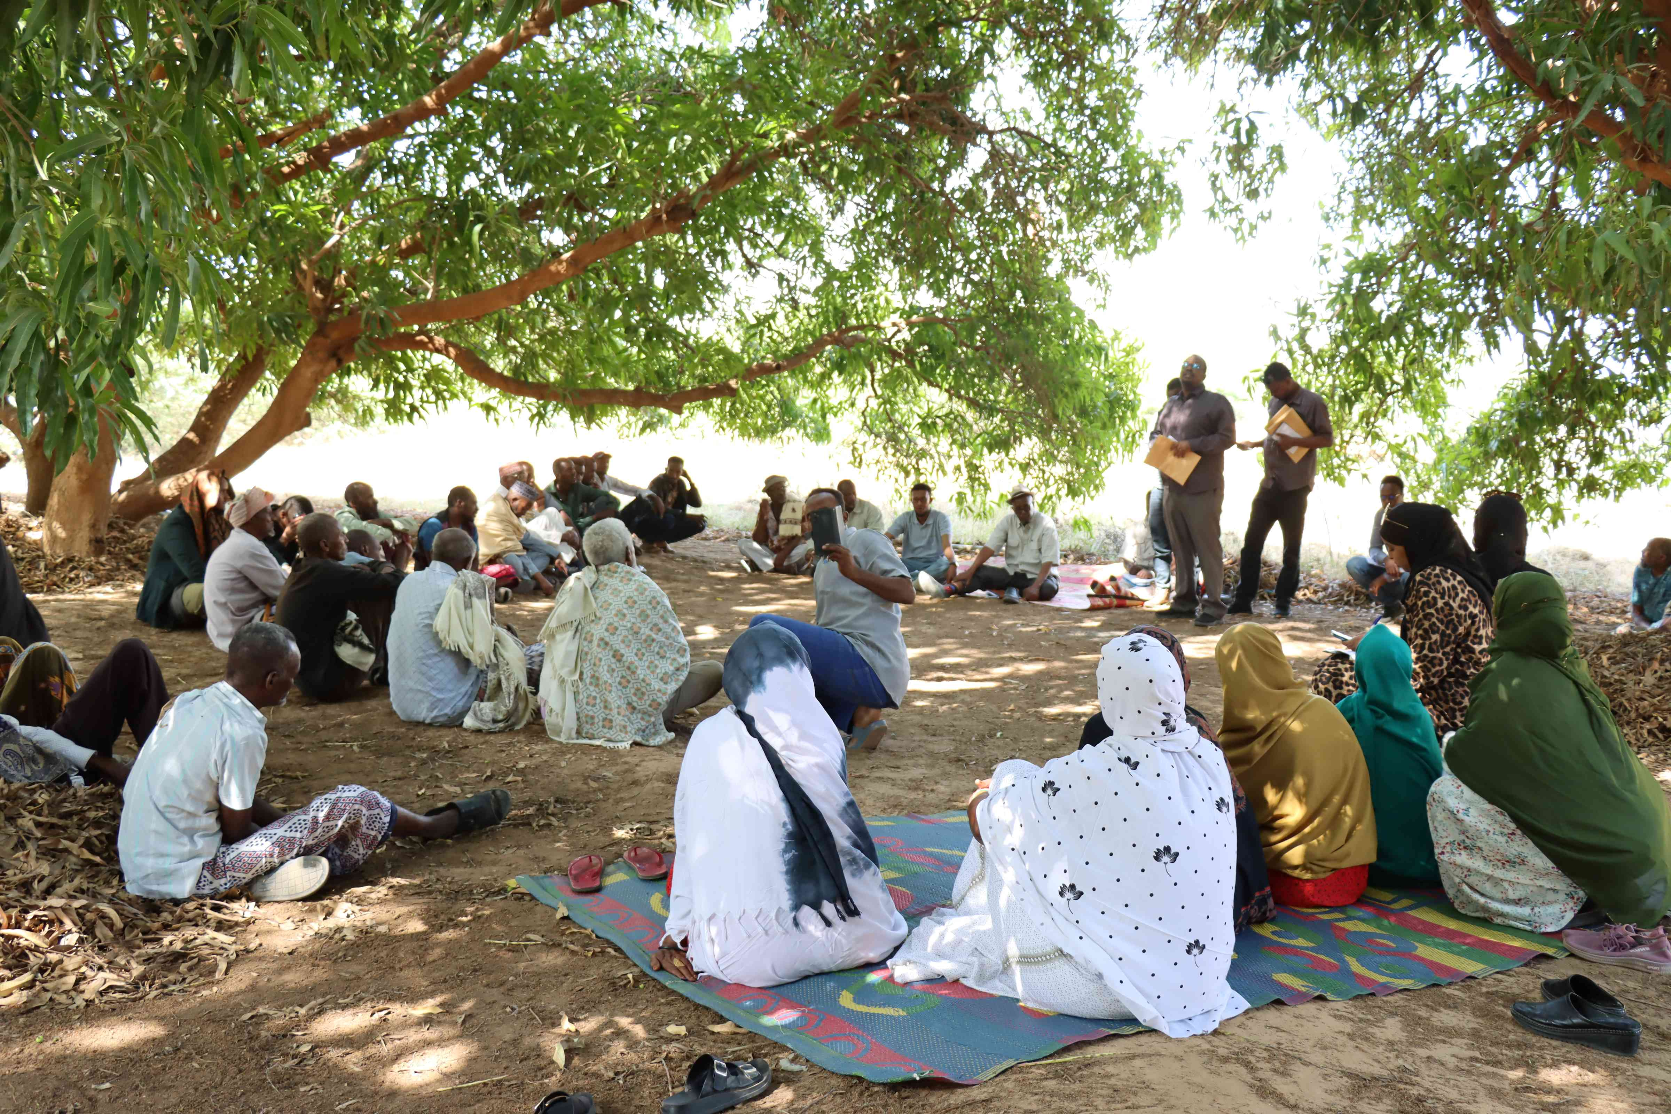
Taariikhda Howsha CIP la qabtay: 3-6 March 2024
Tirada Dadka Lala Tashaday
7 xubnood oo gudiga tuulada ah (5 raga, 2 dumara)
23 Haweena
11 Dhalinyara (8 rag, 3 dumar)
4 kamida dadka naafada ah
14 qoys oo isugu jira kuwa dumar ka masuul yihiin iyo kuwa barakacayaal ah.
11 Beeralay (6 raga, 5 dumara)
9 Xoola dhaqato ah (7 raga 2 dumara)
7 gudiga biyaha ah (5 raga, 2 dumara)
76 bulshada guud ah (53 rag, 23 dumar)
Kooxda CIP Ka Fududaysay (25% ayaa dumar ah):
Qaybta hirgalinta Mashruca Barwaaqo : Khabiirka badqabka degaanka, khabiirka badqabka bulshada, Khabiirka Xagudubyada Jinsiga , Khabirka xidhiidhinta mashruca , Lataliyaha Diyarinta qorshaha horumarinta bulshada.
Khabiirada Ka Socda Wasarada Mashruuca Fuliya: Khabiirada xoolaha, beeraha, degaanka iyo biyaha.
Tuulada Awbarkhadle : Gudomiyaha, Gudiga horumarinta Tuulada , iyo Qaybaha kala duwan ee Bulshada ,
Jadwalka Xilli-Taariiikheedka
Goobta: Awbarkhadle | Abr. | Maaj | Juun. | Luul. | Ogo. | Sebt. | Okt. | Nof. | Dis. | Jan. | Febr. | Maarj.
Sanadka Xiliyadiisa | Gu’ |  |  | Xagaa |  |  | Deyr |  |  | Jiilaal
Roobka | X⁺⁺ | X⁺⁺ | X |  | X | X | X⁺⁺ | X
Xilliga xooluhu calool galaan |  |  |  |  |  |  |  | X | X | X | X | X
Xilligu ay xooluhu dhalaan | X⁺⁺ | X
Wakhtiyada calafka La Heli Karo |  | X⁺⁺ | X⁺⁺ | X |  |  | X | X | X
Wakhtiyada Canaha iyo Subaga la heli karo |  | X⁺⁺ | X⁺⁺ | X |  | X | X
Xiliyada Ugu fican Iibka Xolaha | X | X | X |  |  |  | X | X | X |  |  | X⁺⁺
Wakhtiyada xooluhu ka hayaaman degaanka |  |  |  |  |  |  | X | X | X | X |  | X
Wakhtiyada Cudurada xoolaha badan yihiin | X⁺⁺ | X⁺⁺ | X |  |  | X |  |  | X | X⁺⁺ | X⁺⁺
Xilliga gaajada |  |  |  |  |  |  |  |  | X | X | X | X
Wakhtiyada Cudurada dadka ku dhaca ay badan yihiin | X | X | X | X |  |  |  | X | X | X | X
Wakhtiyada la beero dalagyada muhiimka ah | X⁺⁺ | X⁺⁺ | X⁺⁺ |  | X | X
Xiliga goosashada beeraha |  |  | X |  |  |  | X
Wakhtiyada Deyn qaadasho |  |  |  |  |  |  |  | X | X | X | X
Xilliyada guurka Badan yahay | X | X | X |  | X | X | X
Waqtiga dugsiyada la dhigto | X | X | X |  | X | X | X | X | X |  | X | X
Daadadka amma fatahadaha | X⁺⁺ | X⁺⁺
Xiliyada Xanuunada Cayayanada(Ayaxa) badan yihiin |  |  | X |  |  |  |  |  | X
Ciidda Soonka |  |  | X | X

Slide 3
Hayadaha/Ururada Tuulada Ka Shaqeeya
Ururka amma Hayada | Shaqooyinka Muhimka ah
Hayada Cuntada Aduunka/SOPA/AWDO/Nagaad | Taageero cunto iyo lacag, sidoo quudinta ardayda iskuulka
Dowlada hoose ee Hargysa | Dayactirka xarunta caafimadka dhalaanka iyo hooyada, sidoo kale bixinta musharaadka shaqalaha xarunta
WHH (Haayad Jarmal Ah) | Dayactir kaydka biyaha, qasabadaha biyaha iyo suuliyaasha
Candlelight/SCI/DRC | Dhsimaha iskuulka iyo qaybihisa kala duwan
Wasaarada Waxbarashada | Mushaharka Macalimiinta
Wasaarda Qorshaynta Qaranka | Biyo-xidheenka dooxada iyo Ukuurgalida arimaha degaanka
Wasaarada Xanaanada Xoolaha | Tobabaro iyo Talaalka Xoolaha
Ururka Dhaliyarada ee Horseed | Maamulida iyo dabargoynta geedka garanwaaga
WHH
SOPAA
Urur Caanalay Ah
Candlelight
AWDO
Ha,ayda Cuntada Aduunka
HYF
W. Waxbarashada
W. Qorshaynta
W. Xanaanada Xoolaha
HLC
SCI
DRC

Slide 4
Howlaha Waxqabad ee Laga Maalgalinayo Mashruuca Barwaaqo
Howlaha waxqabad | Faahfahinta Waxqabadyada (quantities, hectares…)
Dib uhabaynta biyo-xidheenka | Dib uhagaajinta biyo-xidheenka doxa iyo dayactirka bamka ceelka. Sidoo kale hagaajinta solarka saran qolka waardiyaha Dayacticrka qasabadaha biyaha laga cabo oo 6 ah Dib uhabaynta iyo ranjiyaynta Qolalka waardiyaha iyo alaabada Dib uhabaynta meelaha ay biyihu kaso galaan dararka xooluha kacabaan dayactirka suuliyada
Adeegyada caafimaadka xoolaha | Dawooyinka iyo qalabka xoolaha lagu daweeyo, tobarada daryeelayasha adeega caafimadka xoolaha Taagerada adeega caafimaadka xoolaha
Waxbarashada xooladhaqatada | Kor uqaadista wacyiga xoolodhaqata ee ku aadan xanuunada halista ah garashadooda iyo dawayntoodaba
Dhisidda gudi-hosaadka horimanta | Kulamo gudiga horumarinta bulshado oo la ogaysiiyo shurrudaha xubnaha gudi-hosaadka lagu doranaayo iyo bixinta tobabar hordhac, samaynta qaabdhismeed gudi-hosaadka iyo xeer hosaadkodaba
Dhisidda iskaashato suuq-gaynta caanaha | Soo iibinta iyo qaybinta qalabka caanaha loo isticmaalo, Wacyigalin la siiyo dumarka caanaha ka ganacsada
Taageerada adeega beeraha | Soo iibinta abuur tayo sare leh oo loo soo iibiyo beeralayda yaryar ee u nugul abaaraha iyoisbadalka cimilada Soo iibinta, qaybinta iyo rikibaada aqal beereedyad(green houses, Soo ibinta iyo qaybinta qalab gacmeedka beeraha, Qaybint bacaha biyaha lagu kaydsado
Asaasida Iskaashatooyinka beeralayda iyo Kooxaha Dugsiga Beeralayda | Aasasida 4 dugsi beralay iyo bixinta tobabaro ku aadan hababka beeraha cimilada la jaanqadaya sida maamulka cayayaanada iyo xanuunada, iyo hab waraabin casri ah oo biyaha si tartiib ah ugu shuba xididdada dhirta
Dib Usoo noolaynta dhul daaqsimeedka | Dhisida 1344 M oo dherer ah oo moosas carada iyo biyaha qabta oo gadhaya ilaa dhul ah 7 hictar, Dhisida 98m3 biyo xidheenada dhagaxa, 108m3 biya xidheenka gabyanka/siliga iyo 27m3 of Moosaska dhagaxa si loo xakameeyo socodka biyaha roobka, loogana hortago nabaad-guurka dhulka
Tababar Xakamaynta Nabaad-guurka iyo Maareynta Biyaha | Tababaraha, diyaarinta qalabka iyo bugaagta tobabarka
Dhirayn | Beerista 4000 oo geed oo dhirt xerodhaladka ah
Bixinta Girgirayaasha tamarta madhxiya | In loo qaybiyo girgirayasha madhxiya tamarta qoysaska lasoo xulay
Dhisida uru ka shaqeeya dhul daaqsimeedka | In tuulooyinka laga dhiso ururo ka shaqeeya lanasocda maamulka iyo ilaalinta dhul daaqsimeedka

Slide 5
Howlaha kale ee hortabinta u leh tuulada: maalgelinta looga raadinaayo mashruucada kale
Caqabadaha Gaarka Ah | Waxa Loo Bahanyahay in Laga Qabto
Jiritaan la,aanta dugsi sare | In la dhiso, la qalabeeyo oo macalimiina loo keno dugsiga sare ee tuulada
Jiritaan la,aanta tobabarada xirfadaha farsamada gacanta | U abuurista iyo ka qaybgalinta dhalinyarta fursado tobabaro xirfadaha farmsada gacanta
Kala dhinaansha adeegyada caafimaadka bulshada | Taagerada mushaharka shaqaalaha iyo miiska qaliinka ee qolka dhalmada haweenka
Jiritaan la,aanta xarunta kulanka haweenka | In la dhiso lana qalabeeyo xarunta horumarinta haweenka, sidoo kalana loo shaqalaysiyo tobabare xirfad leh
Jiritaan la,aanta adeegyada dadka qaba baahiyaha gaarka ah ee xarunta caafimaadka | In laga dhigo xarumaha caafimaadka kuwa koobsanaya dhamaan adeegyada bulshadu ubaahantahay oo ay ku jiraan kuwa u adeegaya dadka baahiyaha gaarka ah qaba, sidoo kalana lasiiyo taagero maaliyadeed dadka baahiyaha gaarka ah qaba.
Abuurista kaladuwanansho illaha dhaqalaha nolal Malmeedka bulshada | Taageerad dhaqashada shinida, waxsoosaarkeda iyo suuq gaynta waxsoosaarka shinida
Gaadhsiinta biyaha ee xaafadaha | In la sameeyo nidaam qasabado ah oo biyaha gaadhsiya xarunta tuulada iyo guryaha bulshada

Slide 6
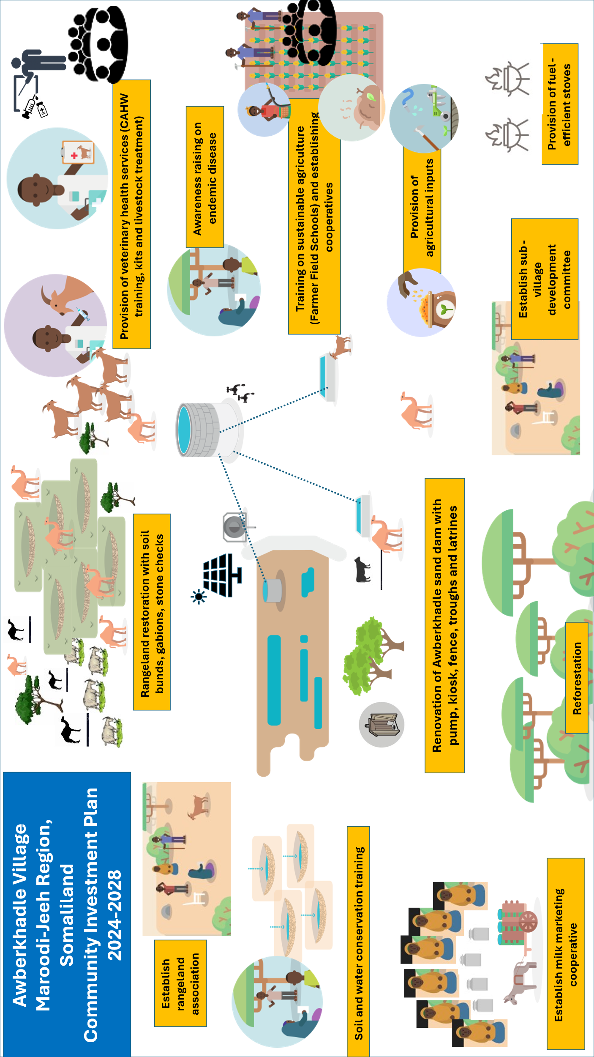
Jaantuska Qorshaha Maalgelinta Tuulada oo Kooban

